Slide 1
Erasmus+ KA210 project
NO.MO.PR.HE -“NOTHING IS MORE PRECIOUS THAN HEALTH”
Project Reference 2021-1-LT01-KA210-SCH-000031353
“Healthy Nutrition”
Polo Tecnico “Fermi-Gadda” Naples, Italy

Slide 2
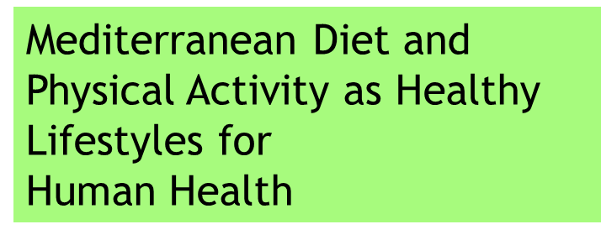
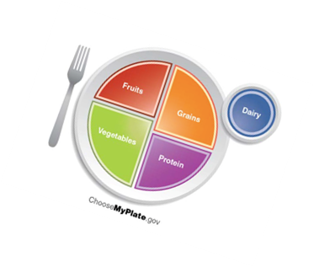
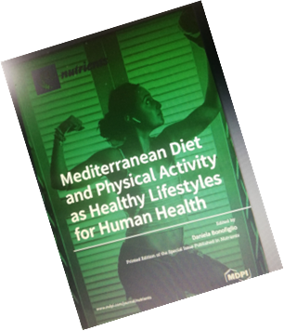
Students involved:
Brancaccio Francesco 4 M
Caputo Michele 3G
Equestre Gennaro 4H
Mecheri Louis 5A
Megna Andrea 4D
ACCADEMIC RESEARCHES

Slide 3
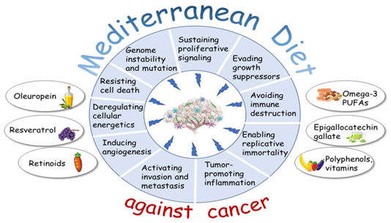
DESCRIPTION
Introduction​
Primary goals
​Areas of focus
​Conclusions

Slide 4
The Mediterranean Diet (MD) is a term used to identify a dietary pattern originating from the unique multi-millennial interplay between natural food resources and the eating practices of people living in the Mediterranean basin. Scientific evidence has described the healthy properties of the MD and its beneficial role in several pathological conditions. The majority of which could be primarily related to its anti-inflammatory and anti-oxidant properties as well as the effectiveness of this dietary pattern in controlling waist circumference and obesity

Slide 5
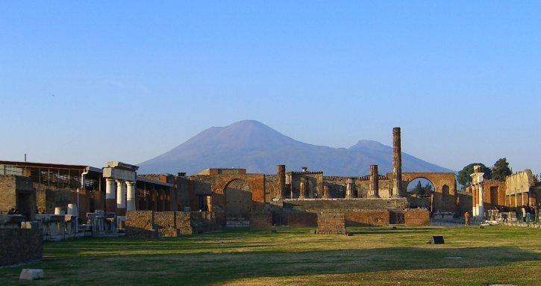
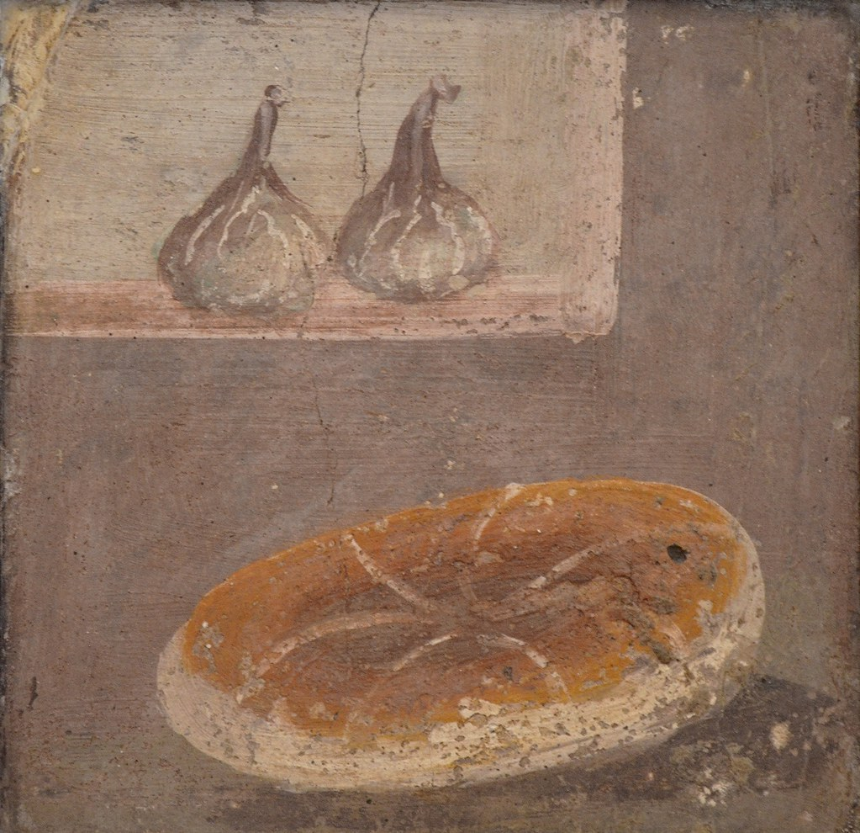
Pompei, near Naples, was a Roman city that was buried in ash after the volcanic eruption of Mount Vesuvius in A.D. 79. Along with grains, the waste revealed that the commoners of Pompeii ate a simple, but fairly varied, Mediterranean diet that included lentils, olives, nuts and fish, as well as the odd scrap of salted meat.
Ancient civilizations

Slide 6
This Special Issue of Nutrients entitled “Mediterranean Diet and Physical Activity as Healthy Lifestyles for Human Health” welcomes original research and reviews of the literature concerning this important topic.
It is an academic research based on:
analysing, collecting and monitoring the benefits of a MEDITERRANEAN DIET (MD), including eating habits and PHISICAL ACTIVITY (PA)

Slide 7
MAIN CHARACTERISTICS OF MD
• Increased interest in food education over the last few decades
• High intake of vegetables, legumes, fruits, nuts, dairy products and non-refined cereals.
• Moderate intake of fish and poultry.
• Low intake of red meat and sweets.
• Recognised as a model for healthy eating.
• Reduces risk of metabolic and non-communicable diseases, including type 2 diabetes, metabolic syndrome, obesity, cardiovascular disease and cancer.

Slide 8
GOALS
1. Combat chronic diseases
2. Combat the widespread habit of skipping breakfast
3. Decrease consumption of unhealthy foods in particular fats (junk food)
4. Avoid the daily consumption of sweets and sugary drinks
5. Counteract an increasingly sedentary lifestyle by promoting physical activity
Educate the new generations to have good eating habits
7. Prefer a varied diet: olive oil, carbohydrates, white meat, fruits and dried fruits, vegetables, legumes, fish….
Eat moderately (daily calorie intake range of 1,600 to 3,200 depending on age, gender, and level of physical activity)
Promote psychosocial resources, community life, mental and social well-being
Treasure and pass on cultural traditions

Slide 9
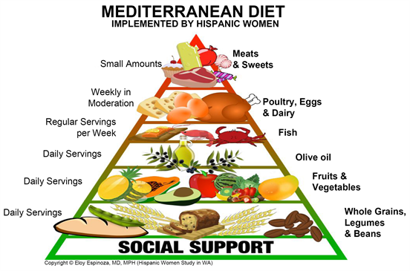
The beneficial effects of the MD on health are not related to individual foods or components of the MD, but likely depend on the combination of foods and the interaction between its components. This concept is called food synergy which is sustained by dietary variety and by the choice of nutrient-rich foods to prevent chronic diseases [28,29]. To evaluate the whole diet pattern and establish the compliance with the MD, several tools have been developed over the last decades.
FOOD SYNERGY

Slide 10
QUESTIONS | CRITERIA FOR 1 POINT
Do you use olive oil as main culinary fat? | YES
How much olive oil do you consume a day? | ≥4 tbsp
How much vegetable servings do you consume per day? | ≥2
How many fruit unit do you consume a day? | ≥3
How many servings of red meat, hamburger, ham, sausage per week? | ≥1
How many serving of butter, margarine,or cream do you consume per day? | <1
How many sweet or carbonated beverages do you drink per day? | <1
How much water do you drink per day? | ≥ 1.5 litre
How many serving of legumes do you consume per week? (150 gr) | ≥ 3
How many servings of fish or shellfish do you consume per week? | ≥ 3
How many times per week do you consume commercial pastries? | <3
How many servings of nuts do you consume per week? (30 gr) | ≥3
How many times per week do you eat pasta, rice or dishes seasoned with tomato sauce, leek, olive oil? | ≥2

Slide 11
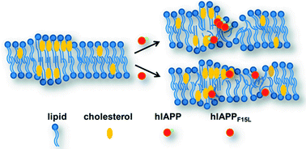
RESULTS
MD FOOD CONSUMPTION OVER THE STUDY PERIOD IN ALL GROUPS OF ADOLESCENTS LED TO A SIGNIFICANT REDUCTION IN THE SERUM LEVEL OF TOTAL CHOLESTEROL AND GLYCEMIA

Slide 12
Areas of focus
The geographical local traditions
Social features
Early Nutrition Education for adolescents
Global dissemination of a balanced and healthy dietary pattern
Eat with “gusto” — “flavour”.
Eat with family members and friends.
Prefer slow food to fast food

Slide 13
CONCLUSIONS
In conclusion, findings from this academic study and other similar ones, show that the introduction of a personalized food plan based on MD principles in an adolescent sample led to a significant improvement in glucose and lipid profile in the follow-up, particularly when subjects adopt the typical MD food choices. This demonstrates the effectiveness of food education programs and how these are implemented and translated into good eating habits associated with PA in the adolescent population and for the entire lifetime.

Slide 14
THANK YOU
Convincing evidence indicates the need to promote healthy nutrition and PA to achieve benefits in terms of the prevention of risk factors for metabolic and chronic diseases. In this context, a carefully designed NUTRITION EDUCATION PROGRAM (NEP) aiming at enhancing the knowledge of the MD principles for empowering adolescents toward healthy dietary habits may represent a useful tool to ensure a better quality of life in adulthood.
Nevertheless, current socio-economic trends have moved people away from this healthy lifestyle. Thus, clinical and biological evidence supporting the benefits of the Mediterranean Diet is needed to overcome these limitations.

