Slide 1
Erasmus+ Project NOTHING IS MORE PRECIOUS THAN HEALTH 1st Learning-Teaching-Training Activity Joniskis Ausros Gimnazija, Lithuania The conclusions of the week
ROMANIAN STUDENTS TEAM
LICEUL “GHEORGHE TATARESCU” ROVINARI, ROMANIA
Gabriel Cimpoeru
Giuliana Caprita
Adriana Marcu
Mario Calota

Slide 2
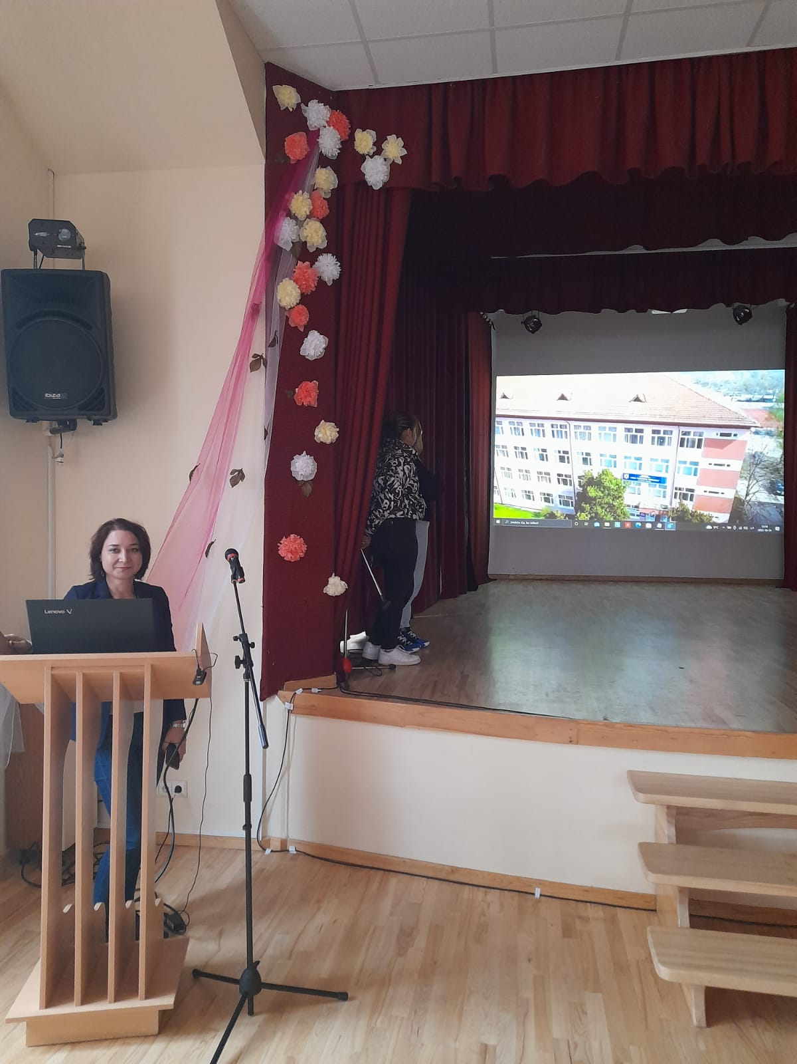
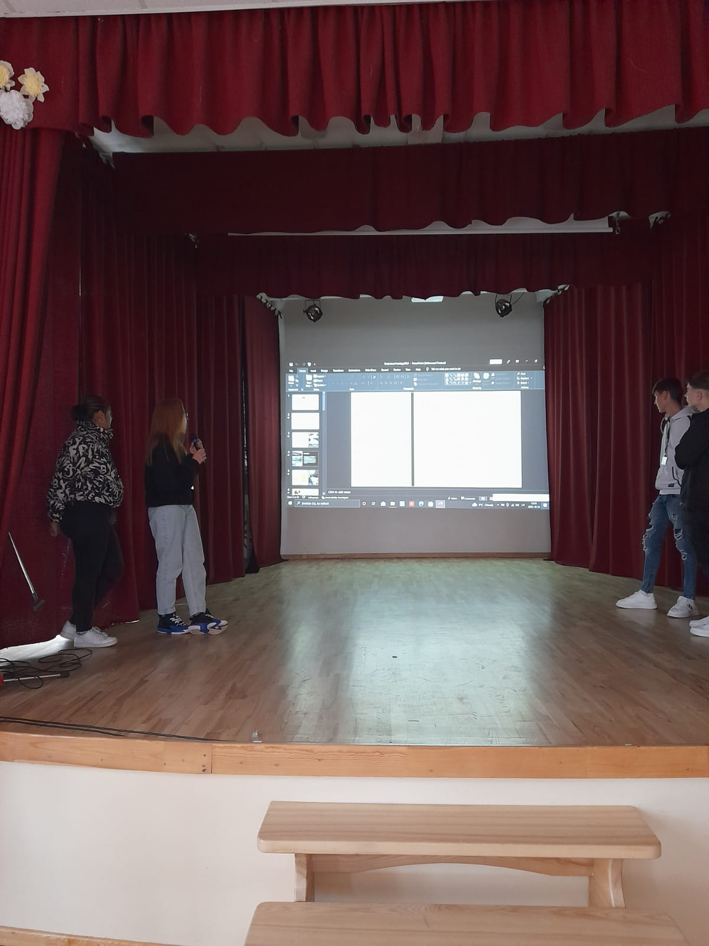
First day
In the morning we had our presentations about our country, school and talking about health.

Slide 3
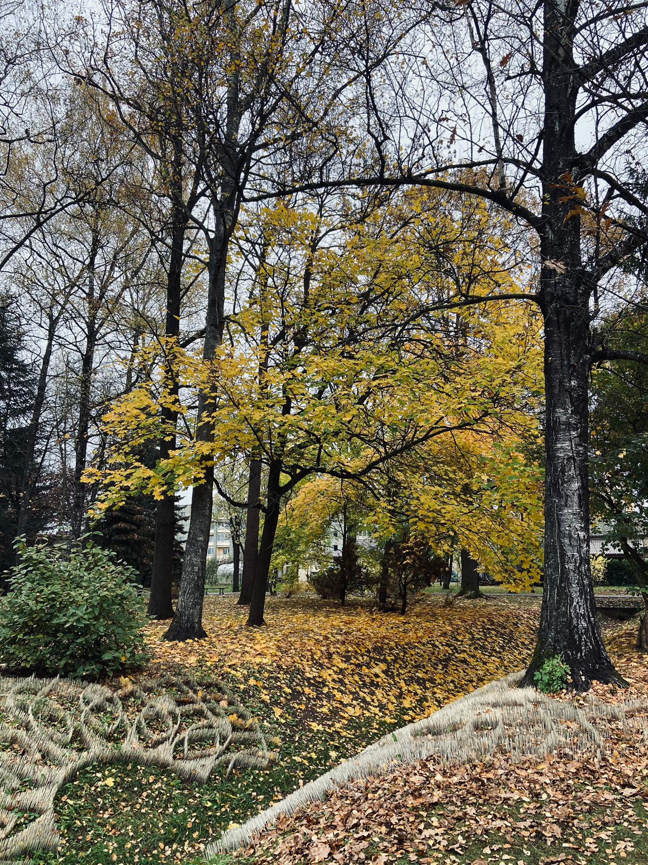
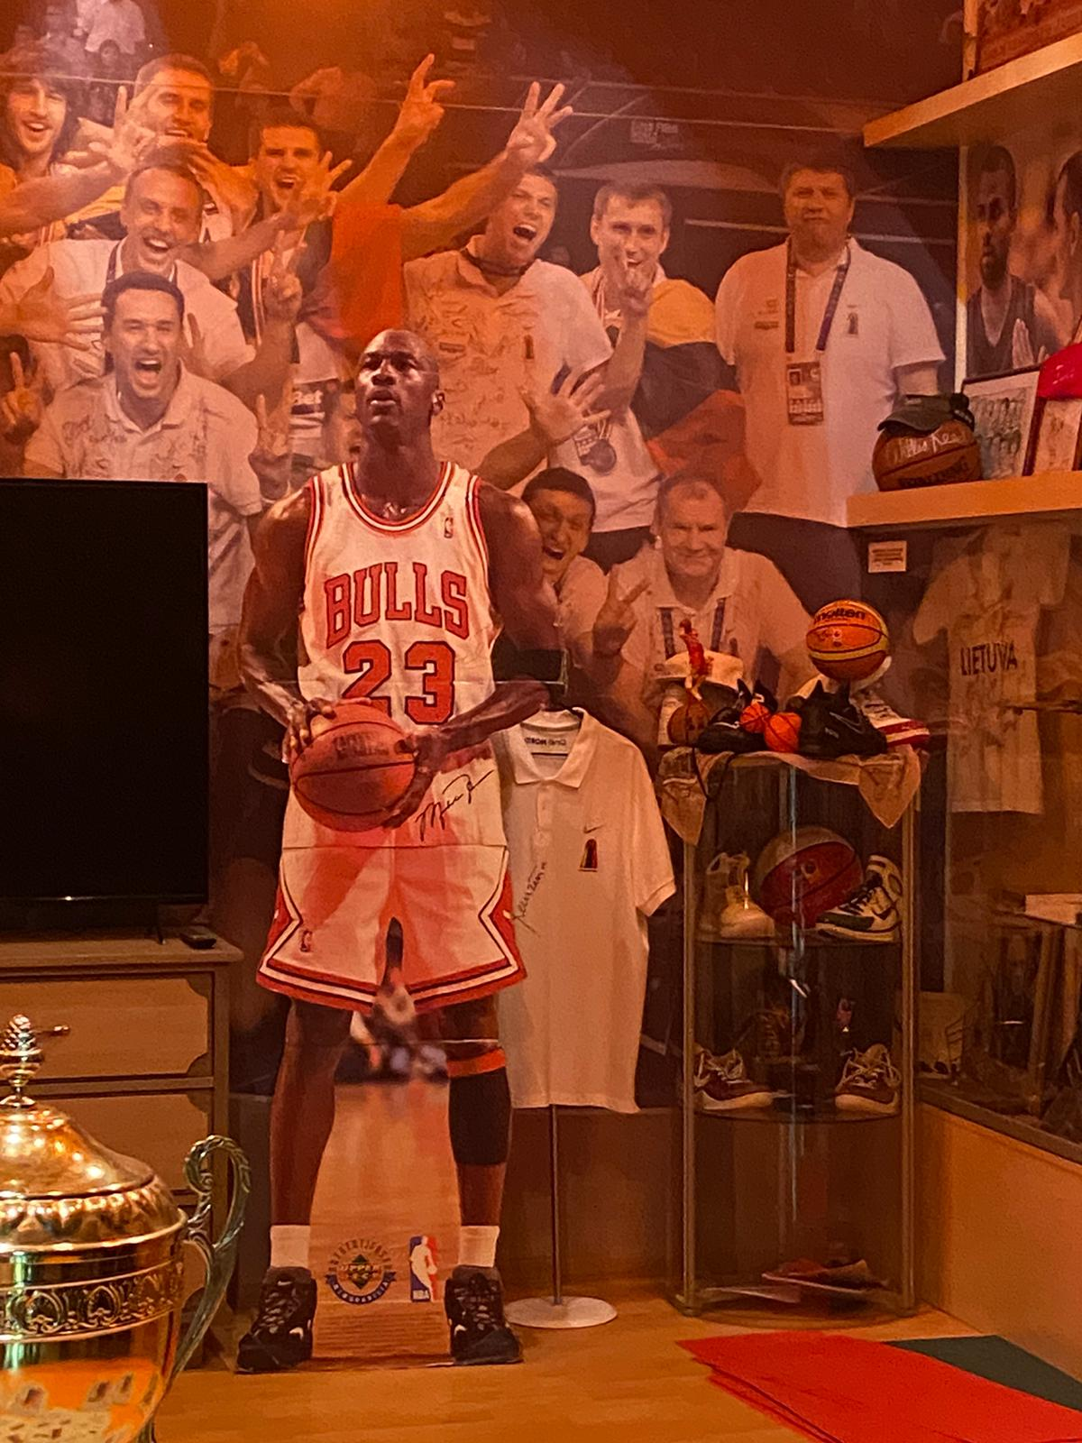
Later, we visited the Tourism Center, the park Joniskis Town, the Basketball Museum, the surroundings.

Slide 4
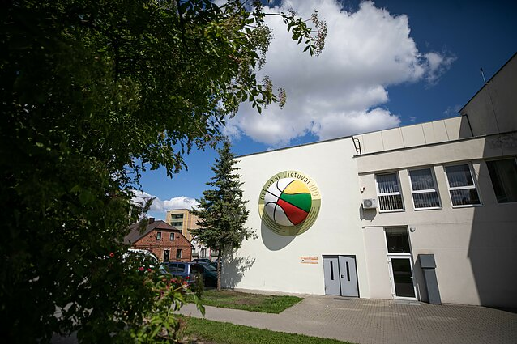

Slide 5
The second day
Cultural visit to Vilnius
-Cathedral and underground ruins and cripts
-Old city ( Saint Johns Church , Saint Ann’s Church )
-Vilnius University
-Presidential Palace
-Vytautas Castle

Slide 6
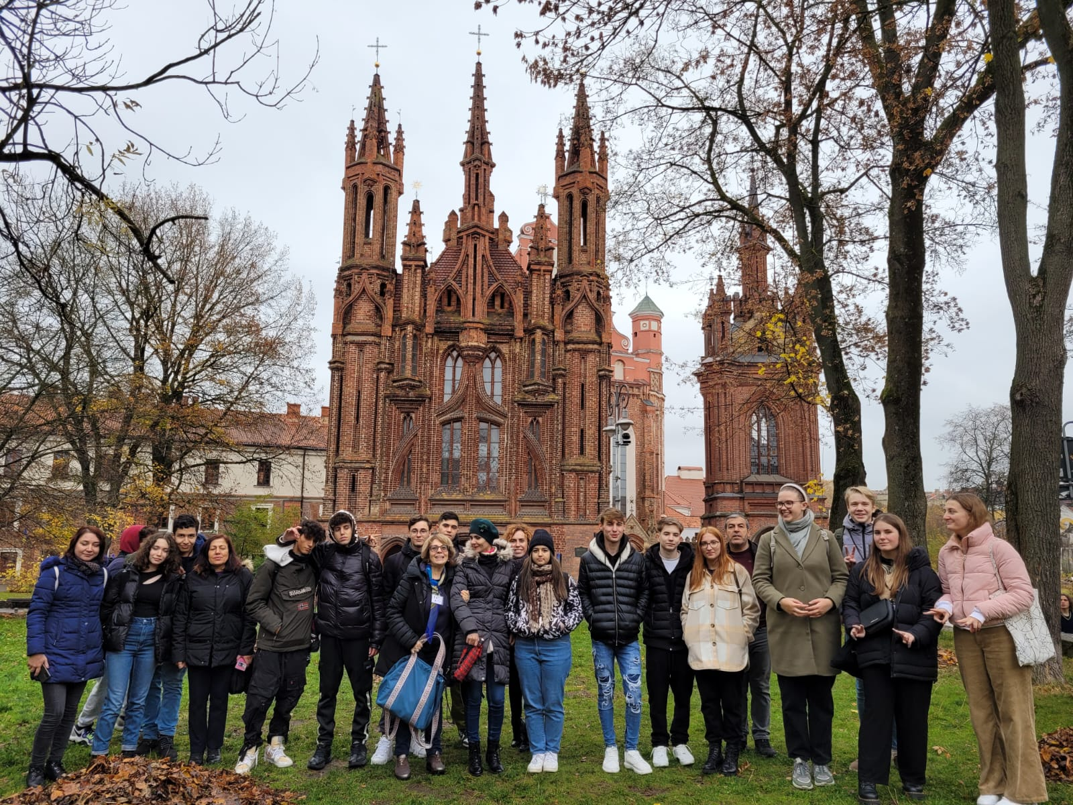

Slide 8
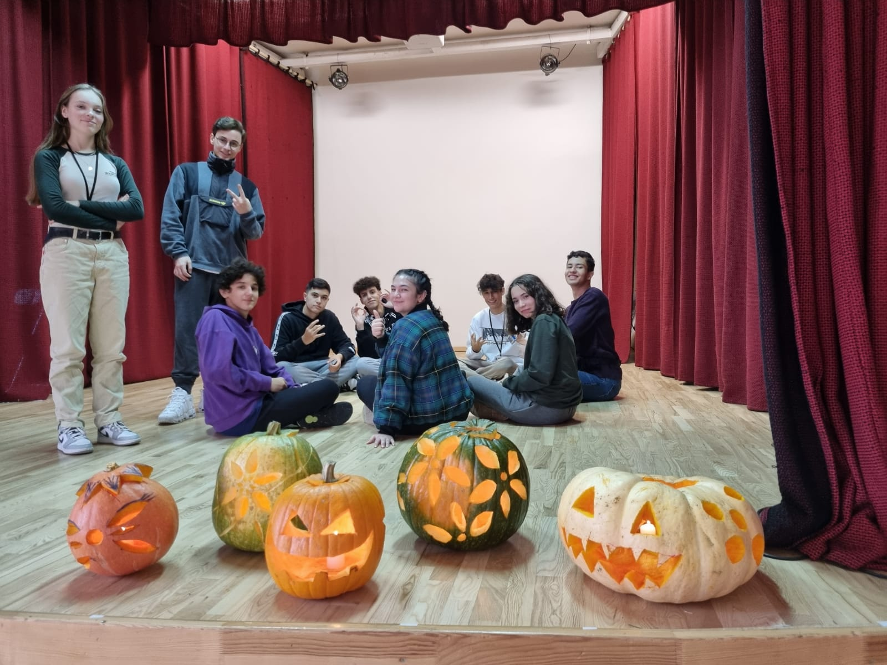
The third day
Joining lessons
Workshop: Decorating pumpkins
Outdoor Activities

Slide 9
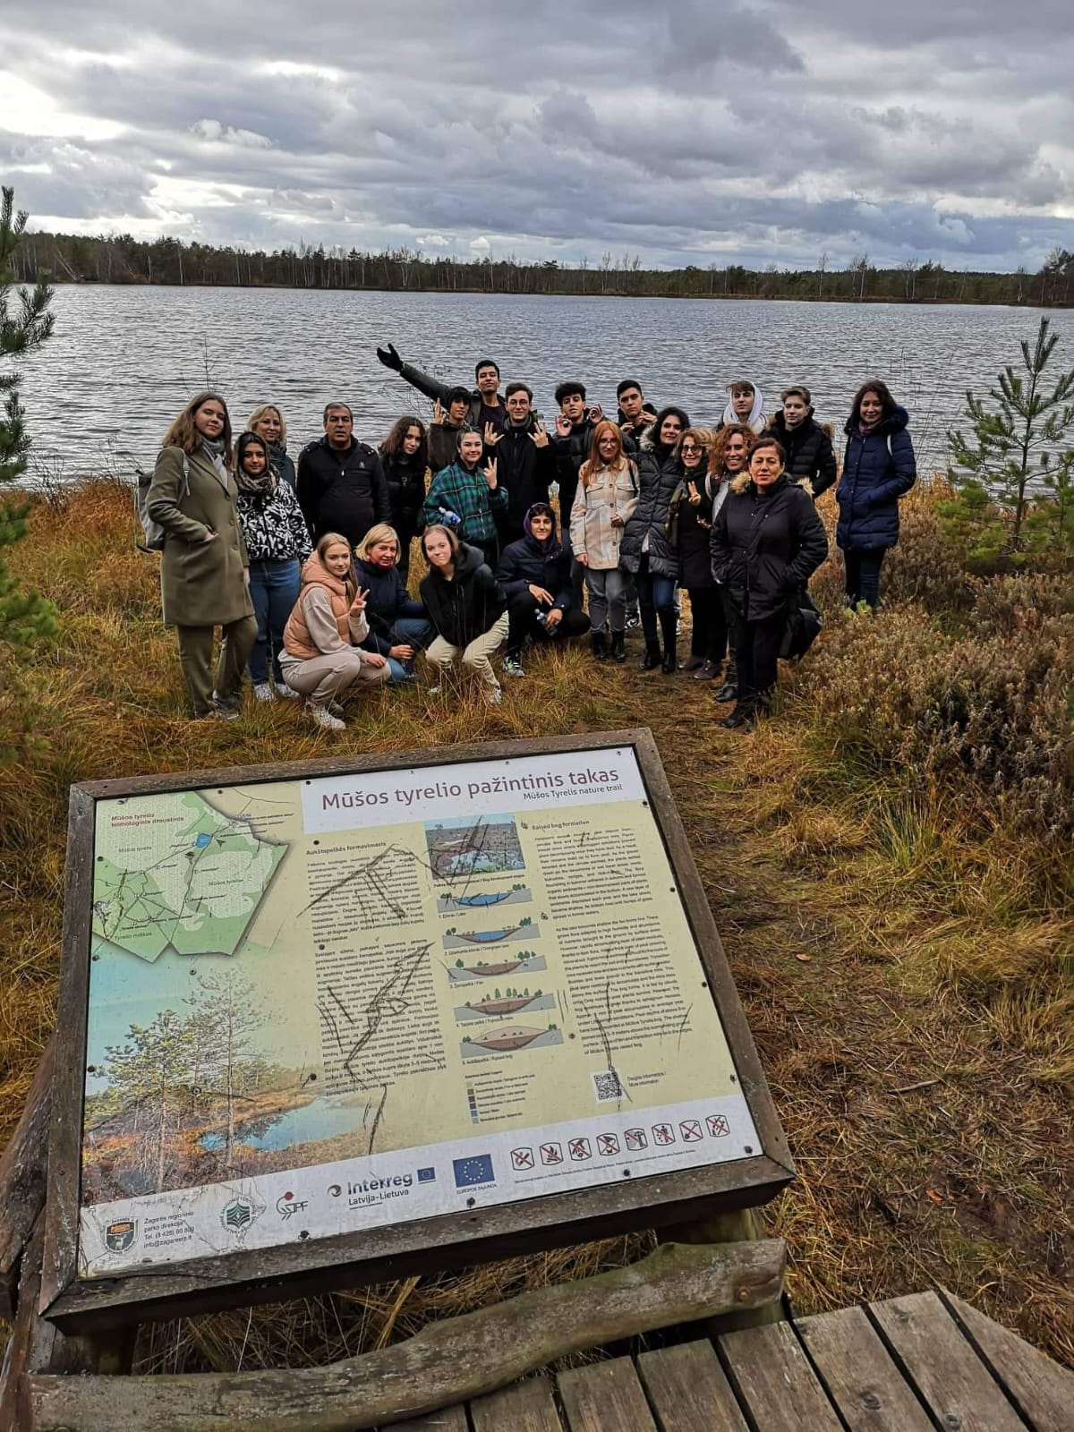

Slide 10
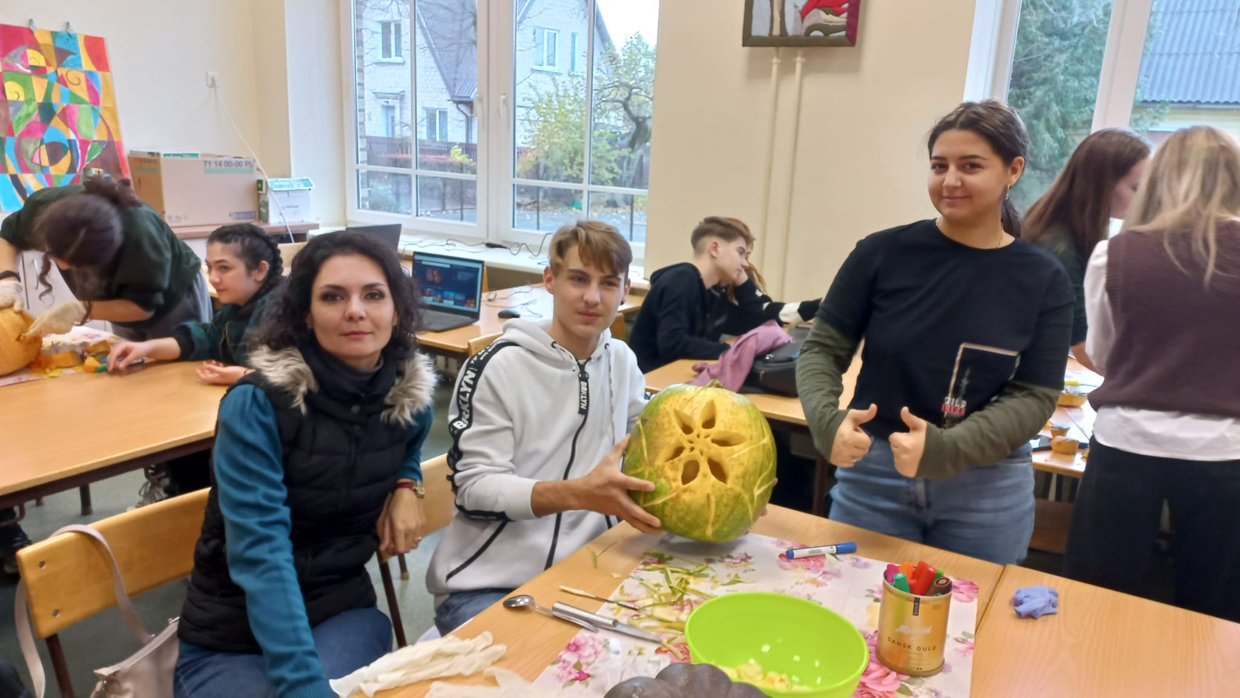

Slide 11
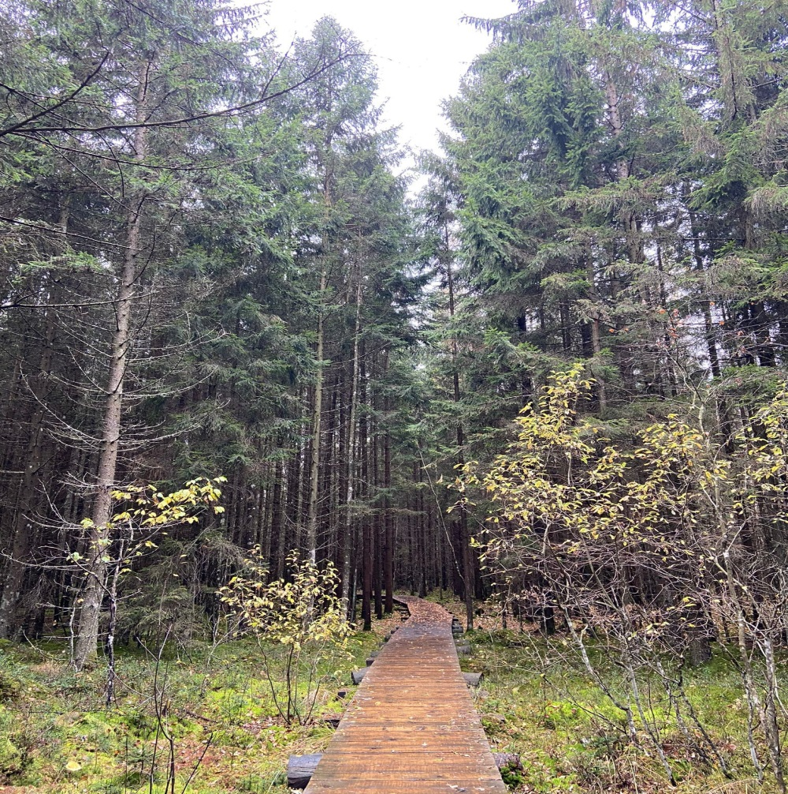
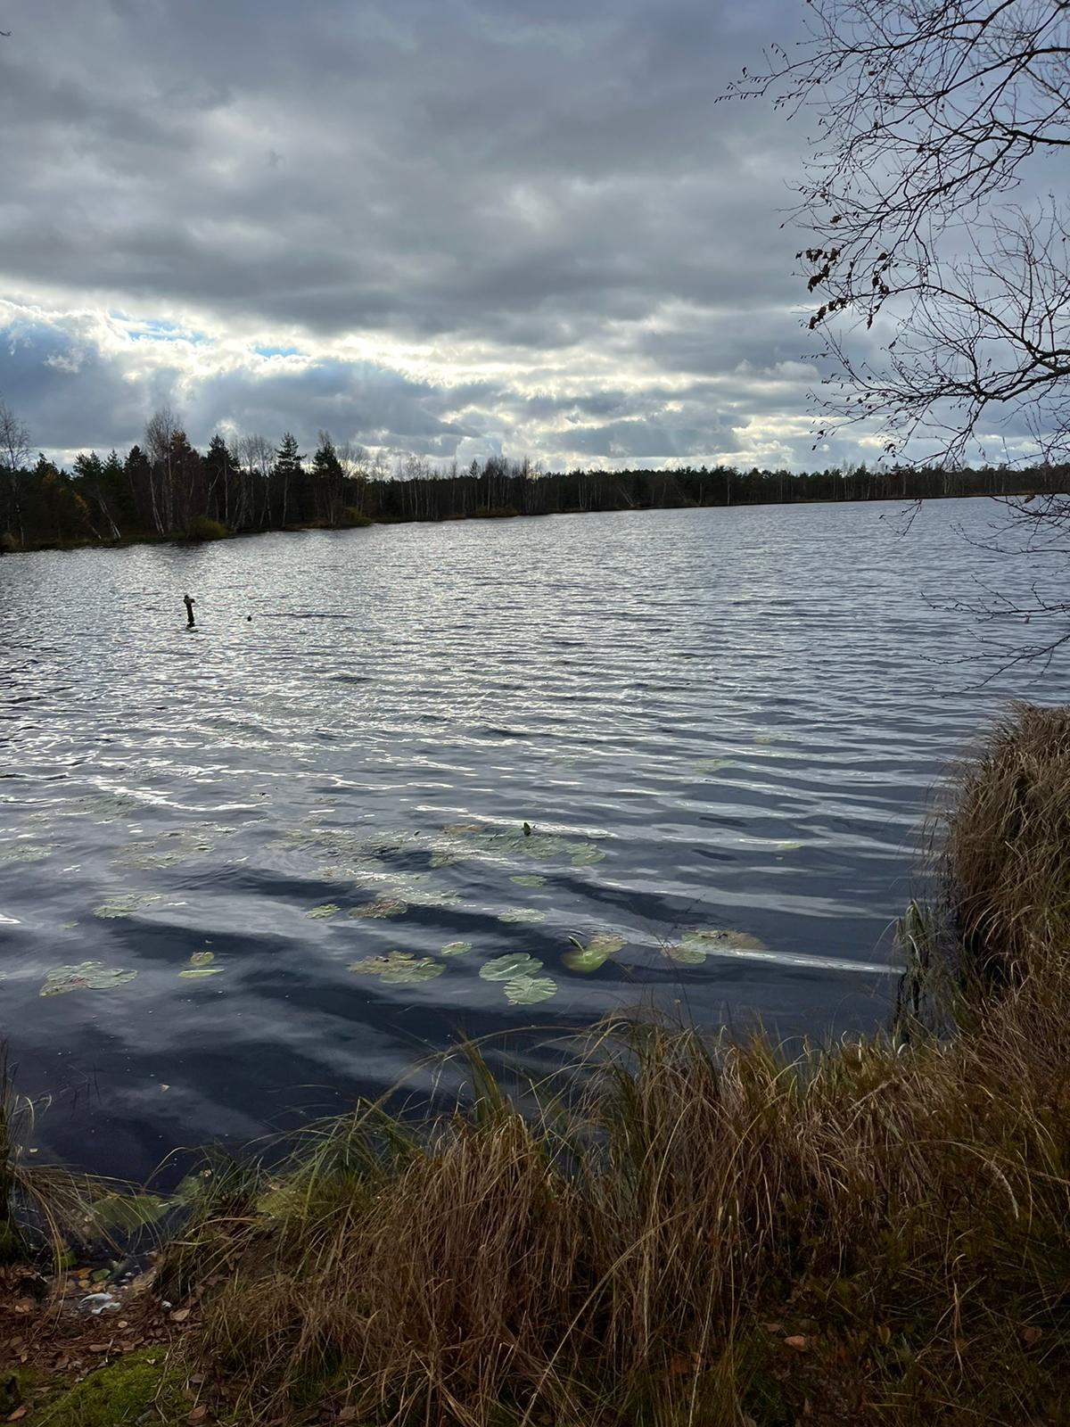
The fourth day
Food and healthy lifestyle Workshop-Presentations of healthy traditional recipes
Trip and sport Activities-National Protected Area- Swamp of Giedre

Slide 12
“Emotions reflect students’
Healthy body”
GIULIANA-“ This project was a whole new experience because I have met new amazing people from each country involved in it.”
MARIO- “This was among the most beautiful mobilities I’ve been in. I’m glad that I’ve learned something from their lifestyles and visited their green areas.”
ADRIANA-”The experience in Lithuania showed me what a healthy lifestyle looks like and the importance of sports in our life.”
GABRIEL-”Being my first experience I was fascinated by the country’s culture and green school and lifestyle.”

