Slide 1
Joniškis Mobility Conclusion
Erasmus+ KA210 PROJECT “NOTHING IS MORE PRECIOUS THAN HEALTH”
POLO-TECNICO FERMI-GADDA
NAPLES ITALY
Matteo De Pasca,
Michele Caputo,
Gennaro Equestre,
Francesco Reggi.

Slide 2
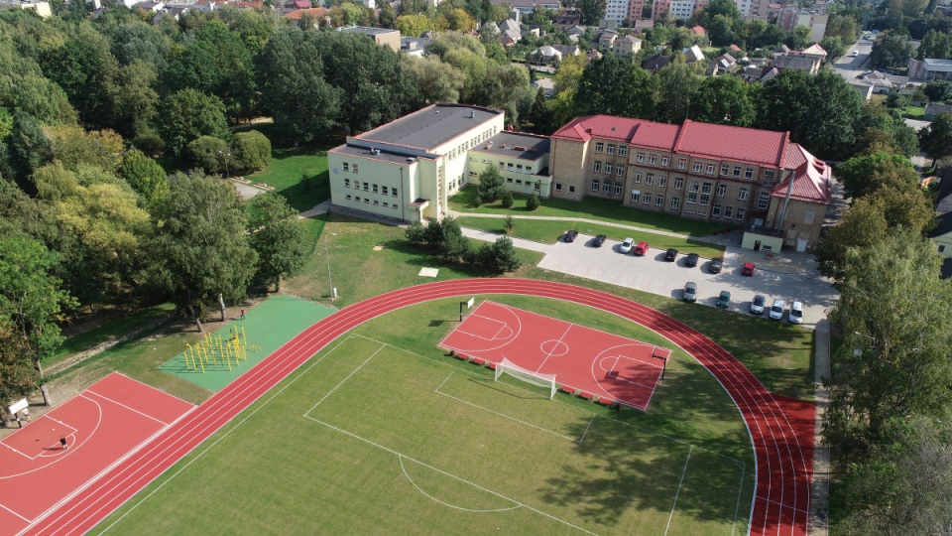
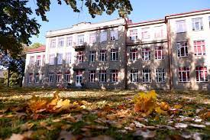
Joniškis Aušra Gymnasium
We really appreciated the building and the activities carried out, having fun and getting to know many students.

Slide 3
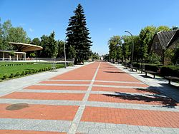
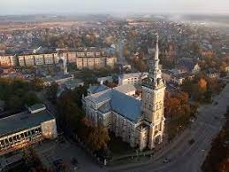
JONISKIS
The city is quite small and the buildings are isolated, not very crowded but with beautiful typical landscapes but is very different from own and flat.

Slide 4
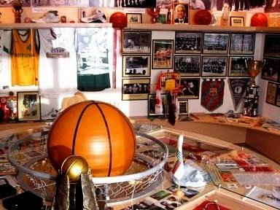
BASKETBALL MUSEUM
The basketball museum amazed and interested us, we were able to see different signed objects and we took some beautiful pictures.

Slide 5
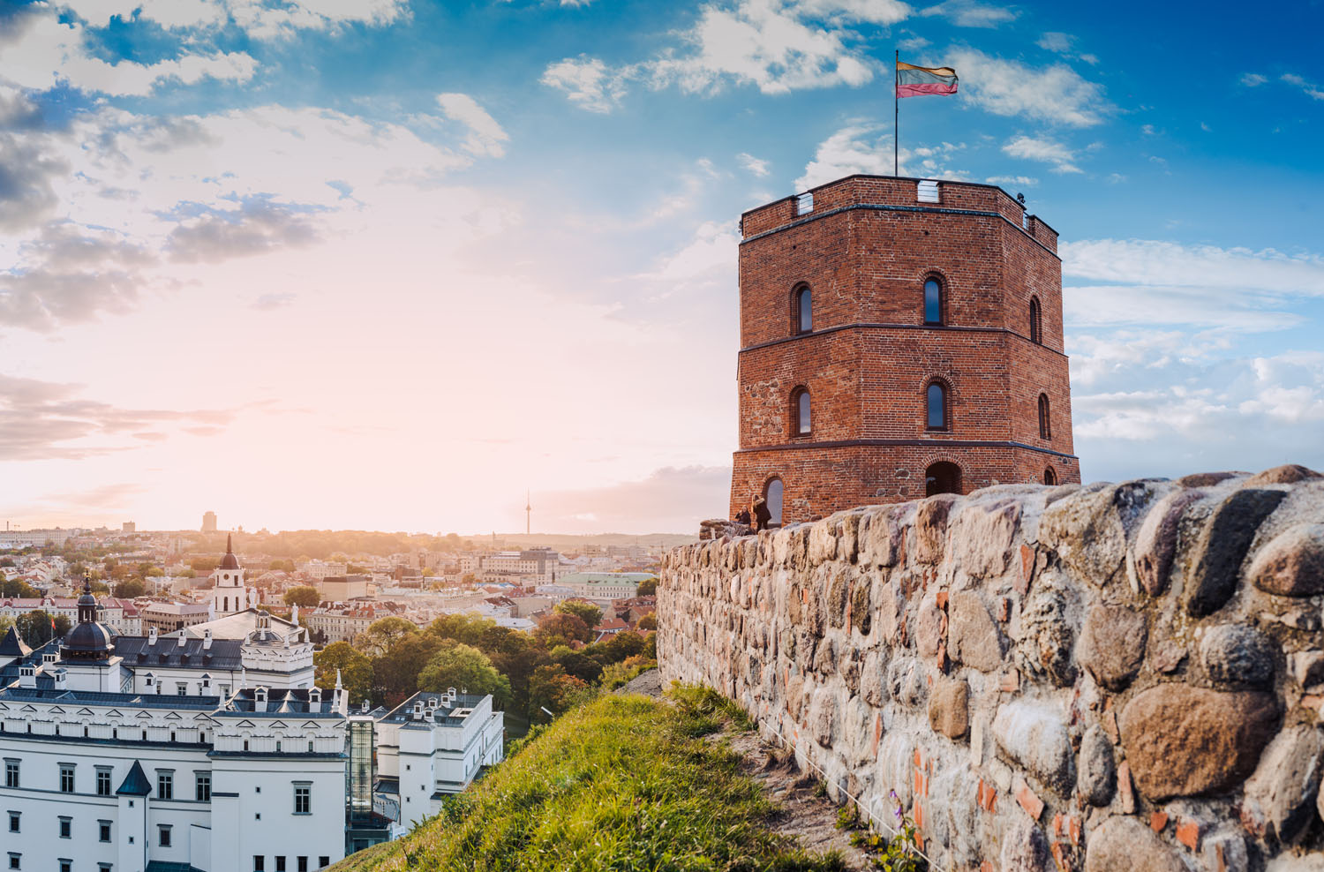
VILNIUS
We visited Vilnius, we particularly liked the castle on the hill which amazed us with a breathtaking view.

Slide 6
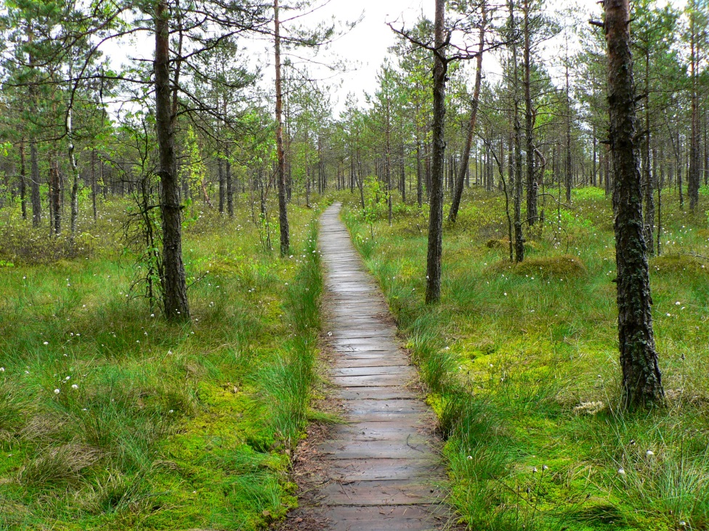
SWAMP
The swamp amazed us a lot for the magnificent landscape it gave us

Slide 7
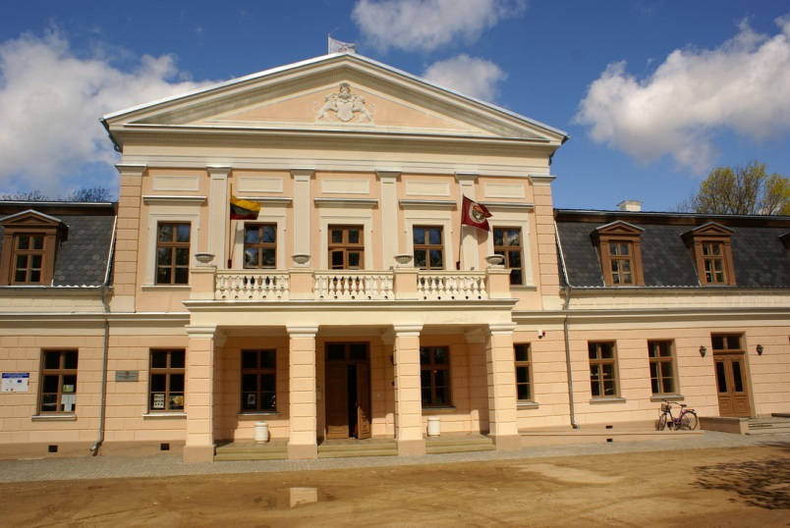
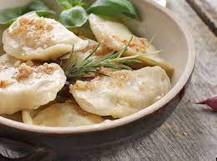
NARYSKINAS PALACE
We were able to try a typical Lithuanian dish ‘dumpling’ that we liked a lot.

Slide 8
RIGA
We visited Riga and enjoyed the variety of buildings very much.

