Slide 1
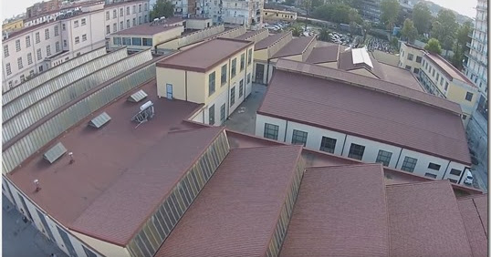
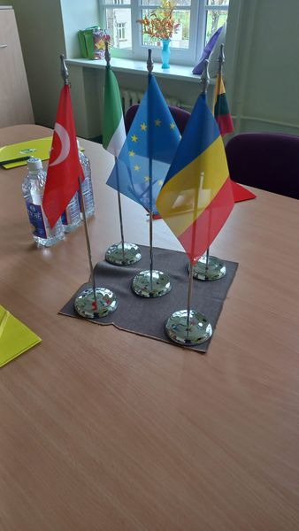
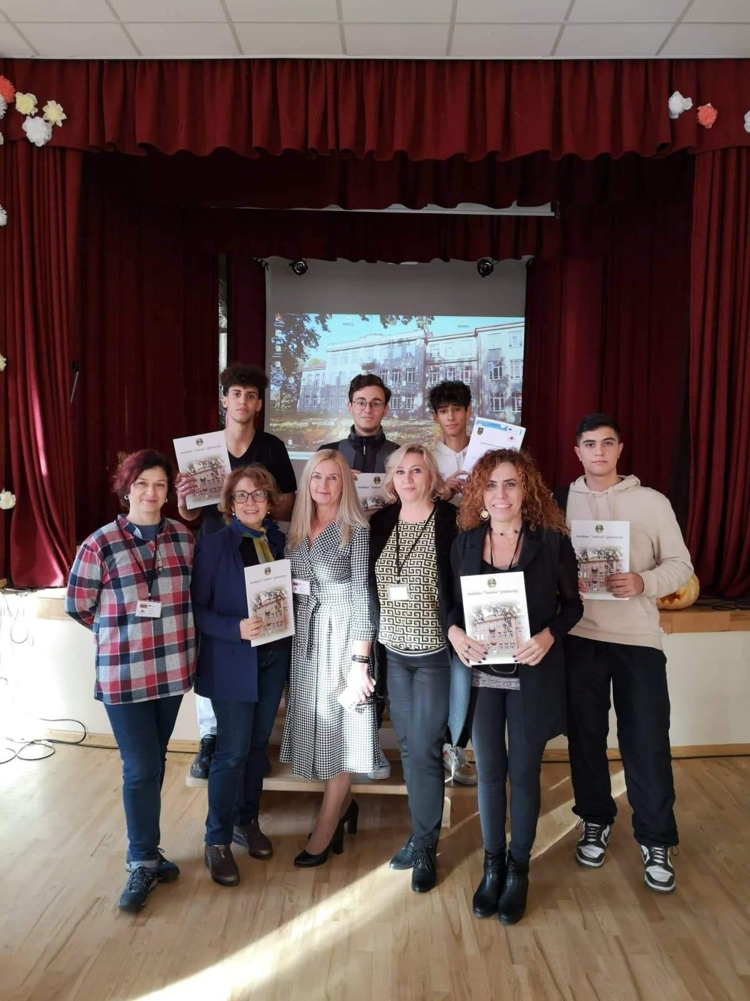
POLO TECNICO FERMI GADDA- NAPLES School Survey with the cooperation of all students
Erasmus+ KA210 PROJECT “NOTHING IS MORE PRECIOUS THAN HEALTH”
POLO-TECNICO FERMI-GADDA NAPLES ITALY

Slide 2
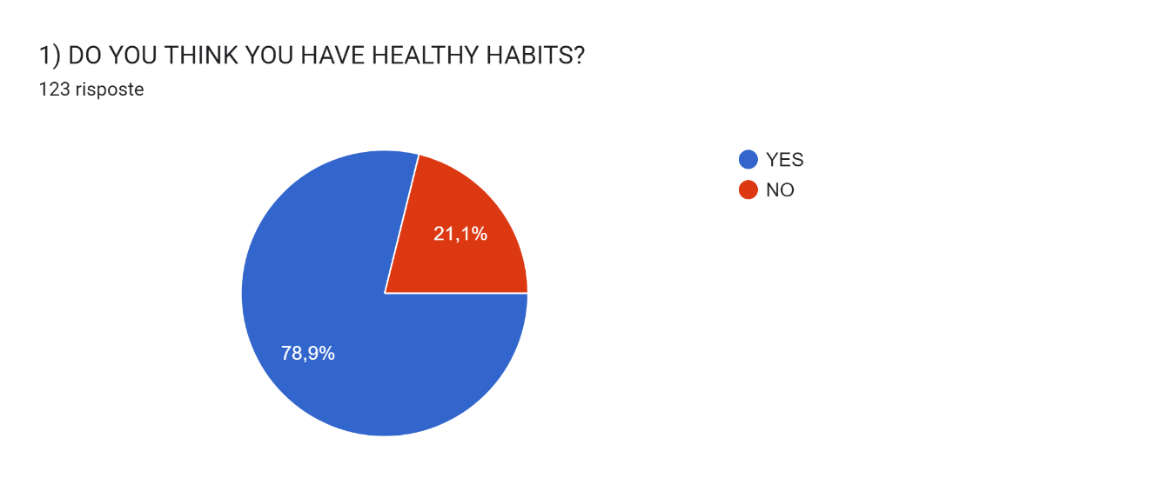

Slide 3
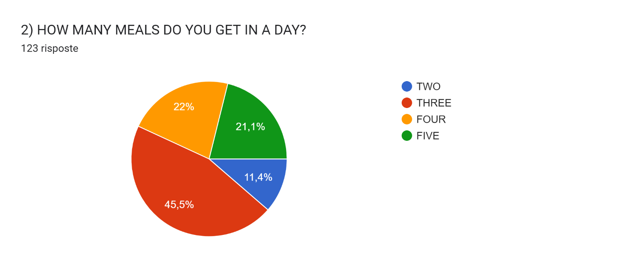
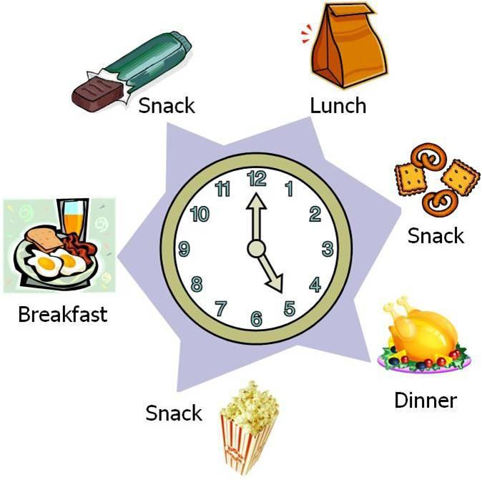

Slide 4
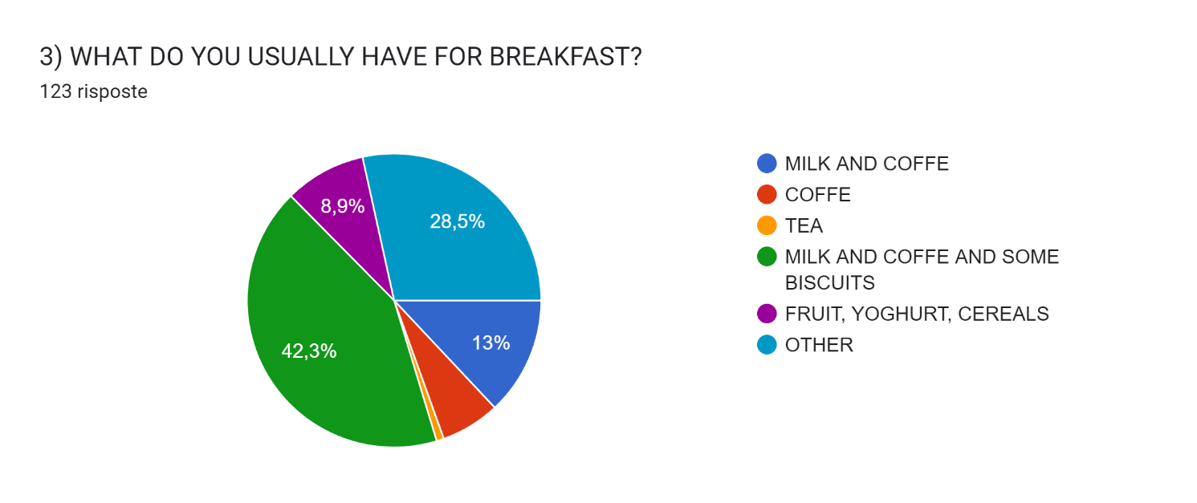

Slide 5
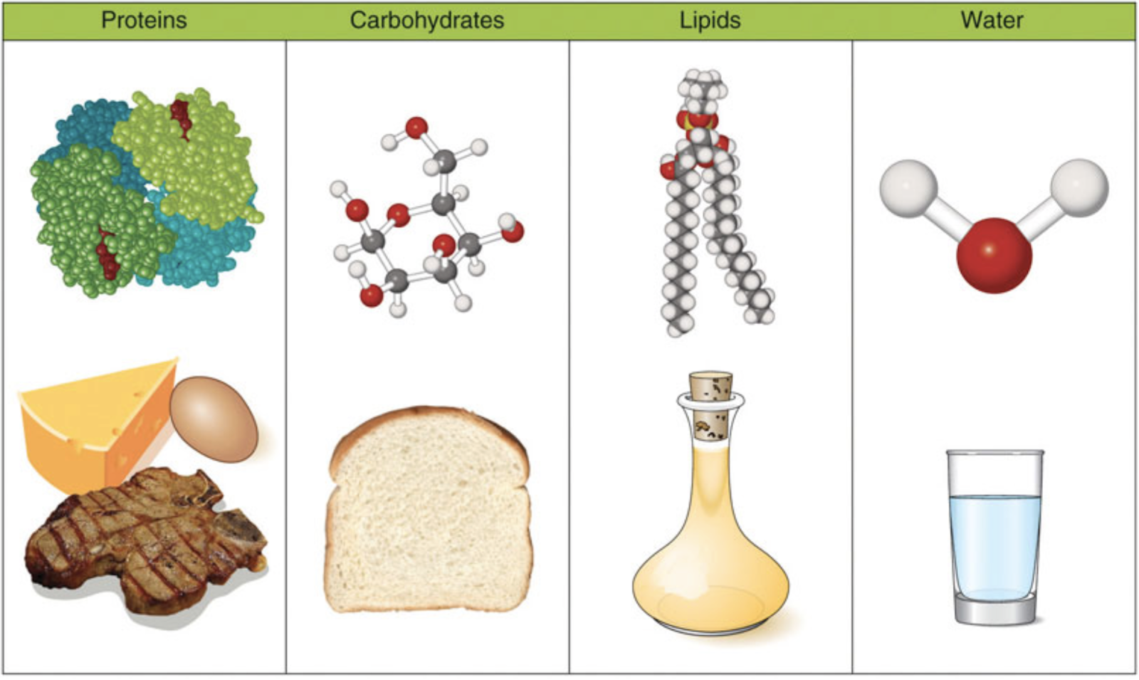
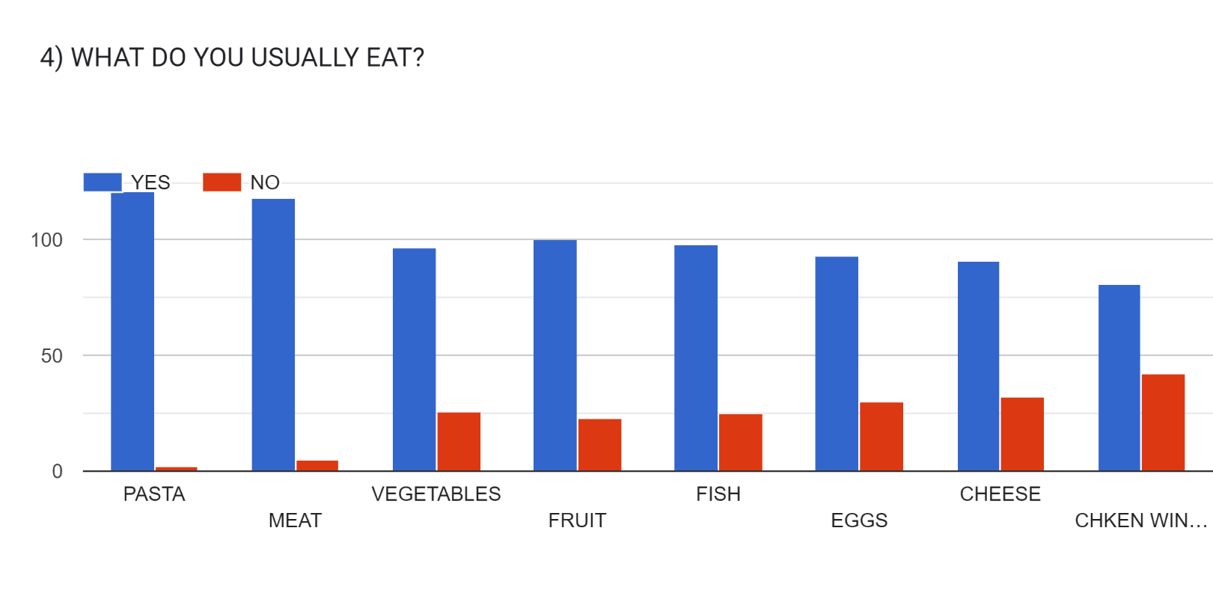
This Photo by Unknown Author is licensed under CC BY

Slide 6
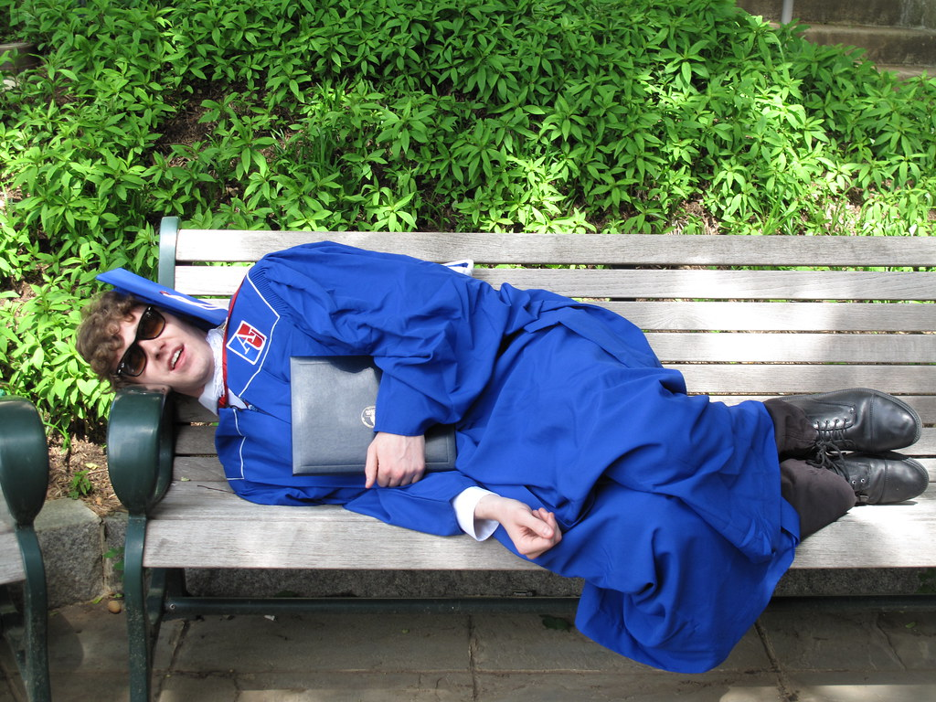
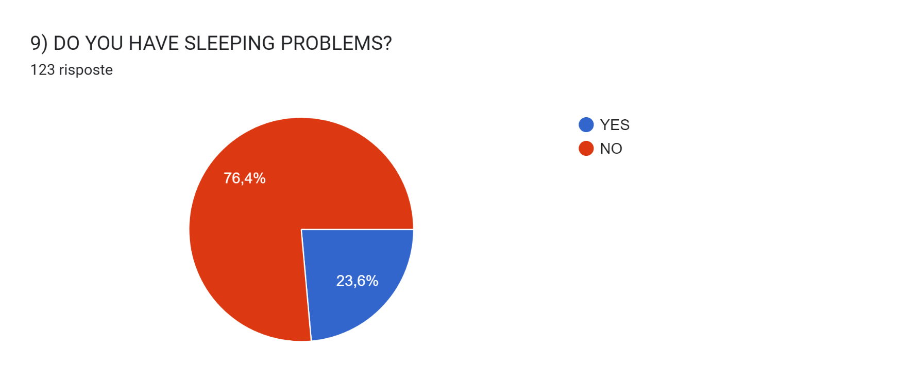
5)

Slide 7
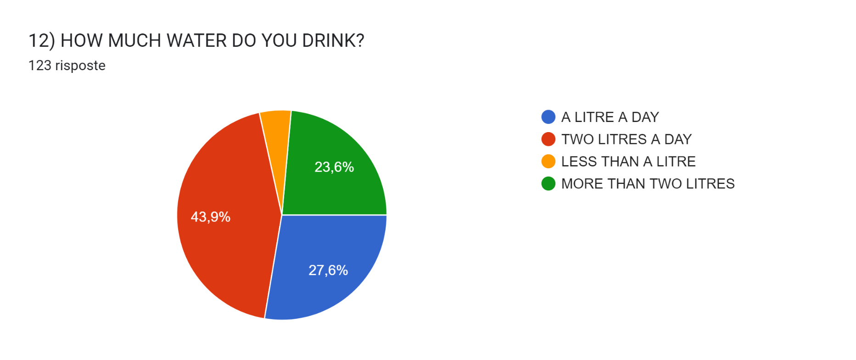
6)

Slide 8
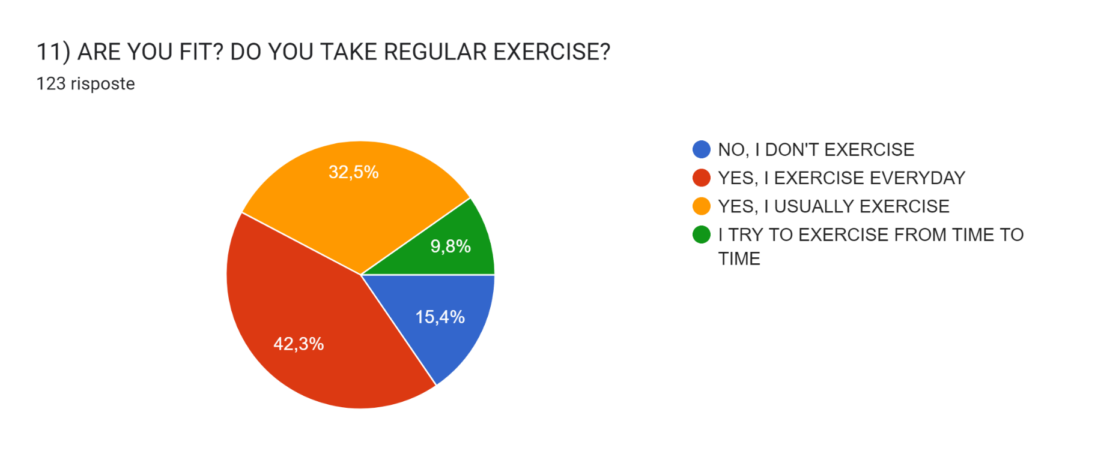
7)

Slide 9
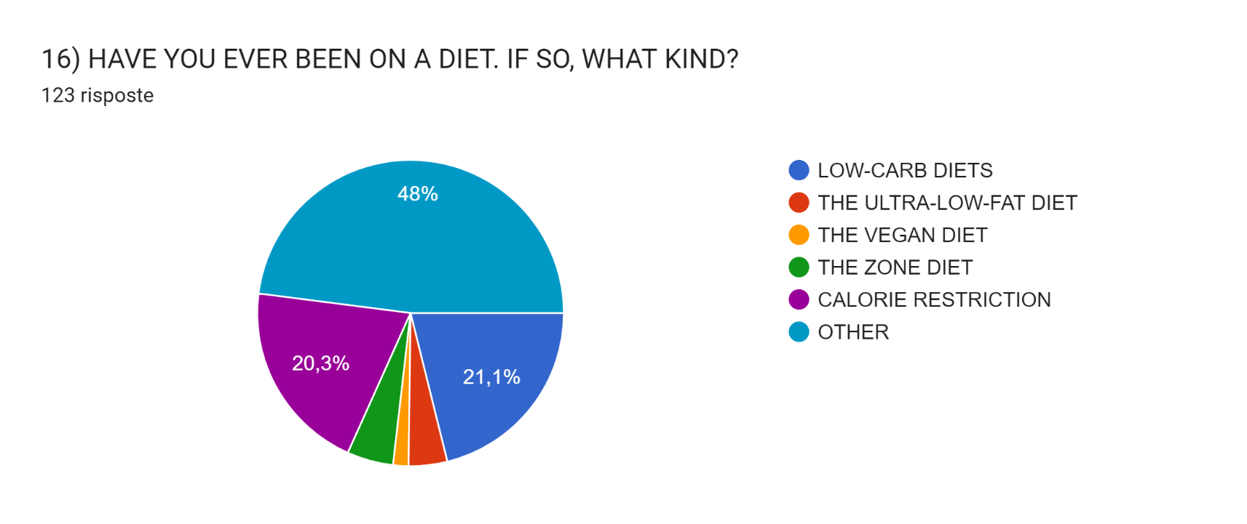
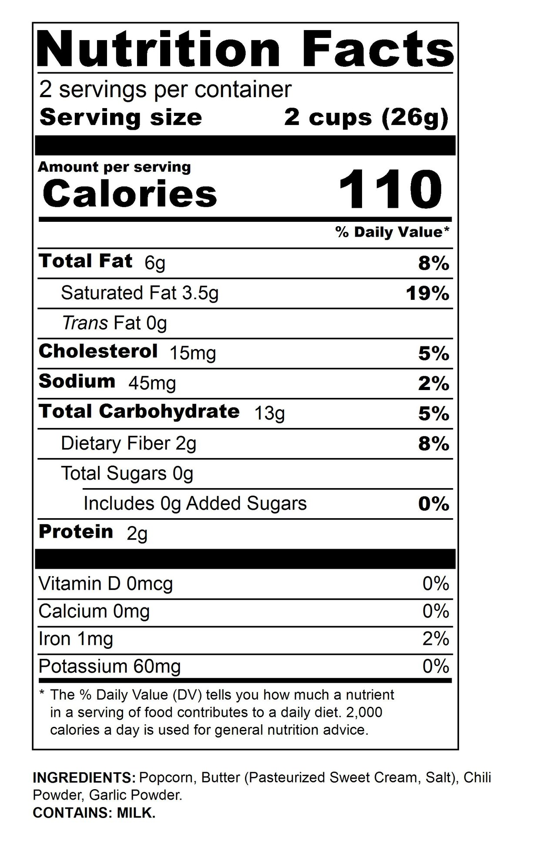
8)

Slide 10
TO ALL THE STUDENTS AND TEACHERS WHO TOOK PART IN THIS SURVEY!

