Slide 1

GORJ NATURAL HERITAGE

Slide 2
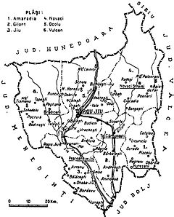
Gorj
This county has a total area of 5,602 km2.
The North side of the county consists of various mountains from the Southern Carpathians group. In the West there are the Vulcanului Mountains, and in the East there are the Parâng Mountains and the Negoveanu Mountains.

Slide 3
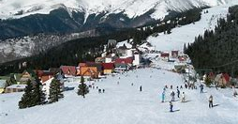
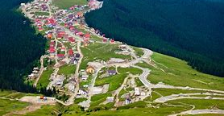
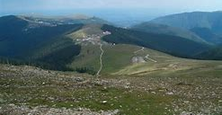
Rânca
Rânca is a recently developed Romanian resort, located at 1,600 m (5,250 ft) elevation, at the foothill of Păpuşa Peak in the Parâng Mountains.
It is located 17.9 kilometers away from Novaci, Gorj County, after passing on the Transalpina (DN67C) road through the Parâng Mountains. There are views of the Parângu Mare peak and, when the weather is clear, one can see Peleaga peak of the Retezat Mountains. During the winter, there are more than five ski slopes open ranging from low to increased difficulty.[1]

Slide 4
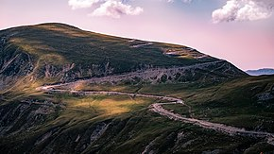
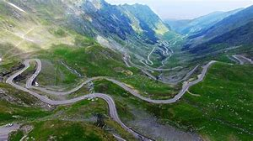
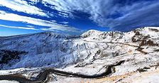
Transalpina
The Transalpina or DN67C located in the Parâng Mountains group, in the Southern Carpathians of Romania, is one of the highest roads of the Carpathian Mountains. It connects Novaci, south of Parâng Mountains, to Sebeş in the north.
The road was built under King Carol II over an old Roman road and consolidated during World War II by German troops. Also a story has it that Nicolae Ceauşescu had the Transfăgărășan Road (DN7C) built during the communist regime just to surpass the Transalpina.

Slide 5
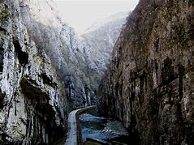
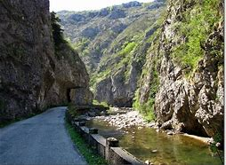
Sohodolului gorges
Sohodolului gorges, cover an area of approximately 350 ha, is a nature reserve in category IV IUCN mixed their unique "tunnels" dug by the river.
Karst topography, name introduced worldwide by J. Cvijic karst science, specifically Sohodolului Gorge, formed by processes of corrosion, erosion and biochemical leading to the emergence of karst surface-Exokarst.

Slide 6
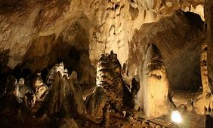
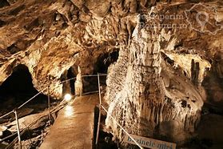
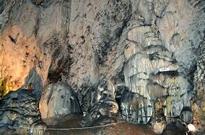
Muierilor(Women)Cave
Muierilor Cave is located in Baia de Fier, Gorj County, on the territory of the Getic depression of Oltenia. The cave was carved into Mesozoic calcharele on the southern edge of the Parâng massif by Galbenul River. With a very rich history, the cave in ancient times shelled during the wars, when men went to fights, many children and women, from where they were named. It is the first electrified cave in Romania.

Slide 7
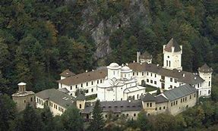
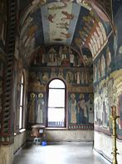
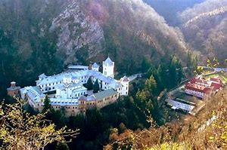
Tismana Monastery
Tismana Monastery is placed on a cliff top, on Mount Stârmina, surrounded by wooded and rocky heights, near the mouth of the Cave of St. Nicodim and from under whose walls the water springs, rolling in the waterfall, with a fall of approx. 40 m in the Tismana River .

Slide 8
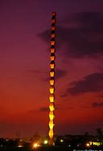
The Endless Column
The Endless Column is a sculpture of the Romanian artist Constantin Brâncusi,and part of the Monumental Ensemble trilogy of Târgu Jiu, consisting of the Infinite Column, the Gate of the kiss and the table of silence designed and executed by him. Inaugurated on 27 October 1938, the column has a height of 29.35 meters and consists of 16 overlapping octaedric modules, respectively with the lower and upper extremities of half a module.

Slide 9
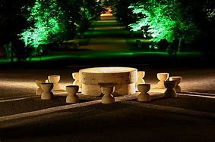
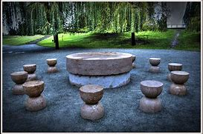
The Table of Silence
Around The Table of Silence, in 1938, the round hourglass chairs were grouped, two by two, but the artist did not leave them, putting them at equal distance from the table and between them, stressing the imaginary presence of a significant circle.
The table is a symbol of family reunification and meditation

Slide 10
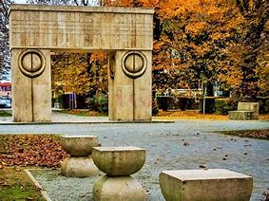
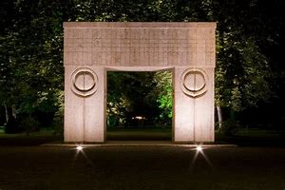
The Gate of the Kiss
The gate of the kiss, which is located in the alley at the entrance of the city park, is chised from porous stone, extracted from the quarries in the surrounding area, consisting of thick, parallelpipedic columns, supporting an architous with more dimensions Larger than the columns, with a width of 6.45 m, height of 5.13 m and thickness of 1.69 m.

Slide 11
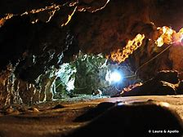
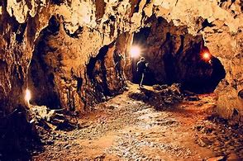
Polovragi Cave
Polovragi Cave is found in the mountain of the mountains, on the banks of the Olt, at an altitude of 670 m and 20 m above the river, in the commune of Polovragi between the towns of Horezu and the Baia de Fier Gorj County, Oltenia, Romania.
Starting from the monastery of Polovragi, the one that sneers as a barrier to the end of the main street of the commune, we dare to climb the keys, initially along the Polovragi forest, protected natural Area for edible chestnut and the vegetation of type Mediterranean.

Slide 12
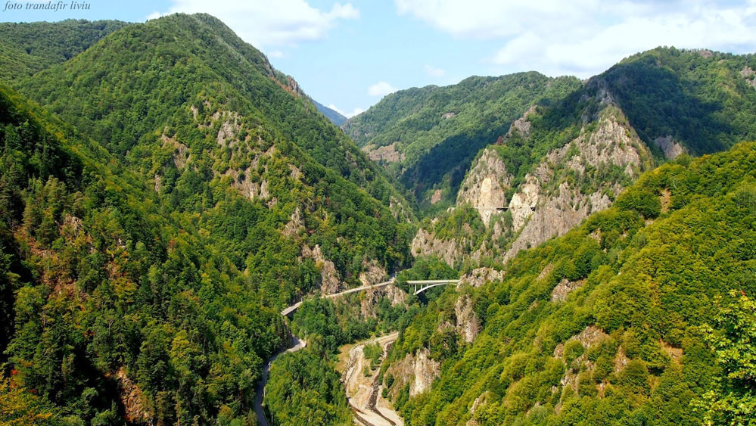
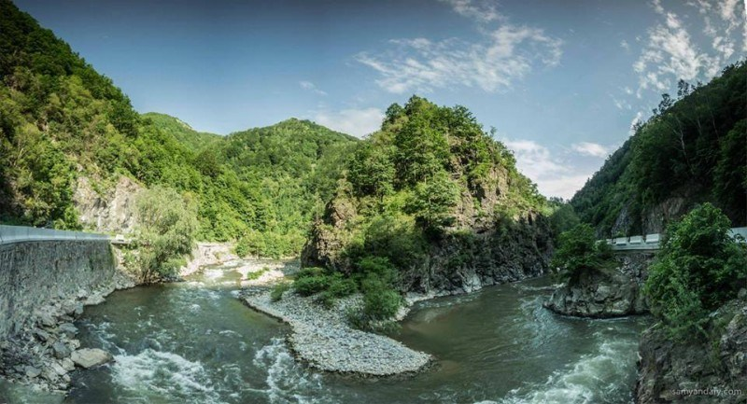
JIULUI GORGE NATIONAL PARK
One of the most spectacular roads in Romania is the GORGE of the JIULUI. This gorge is located between the mountains of Valcan and the Parang Mountains (between which they celebrate the sinuous waters of the Jiu River) and is part of the National Park of Jiului Gorge.
At the same time, the gorge of the Jiul splits and the group of Mountains Parang of the mountains group Retezat – Godeanu. The gorge of the Jiului begins north of Bumbesti and continues until the Iscroni municipality (where the confluence of the 2 streams of the Jiu River) is held.

Slide 13
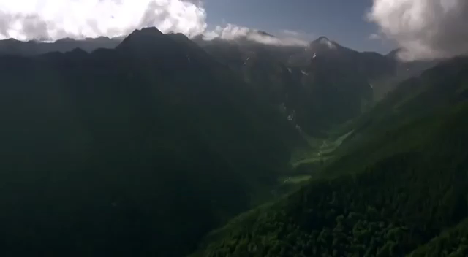

Slide 14
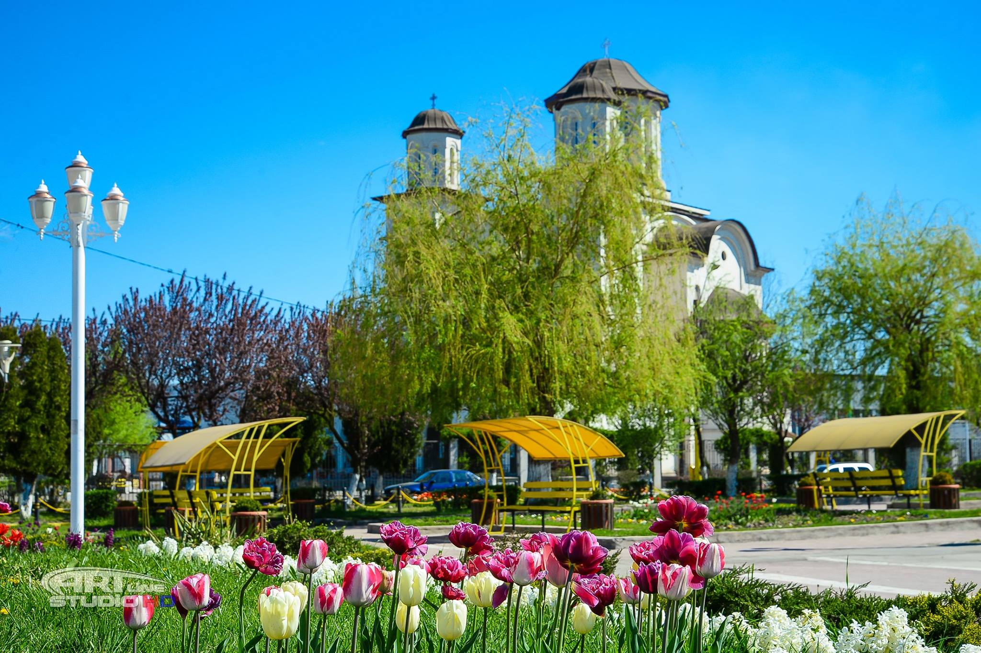
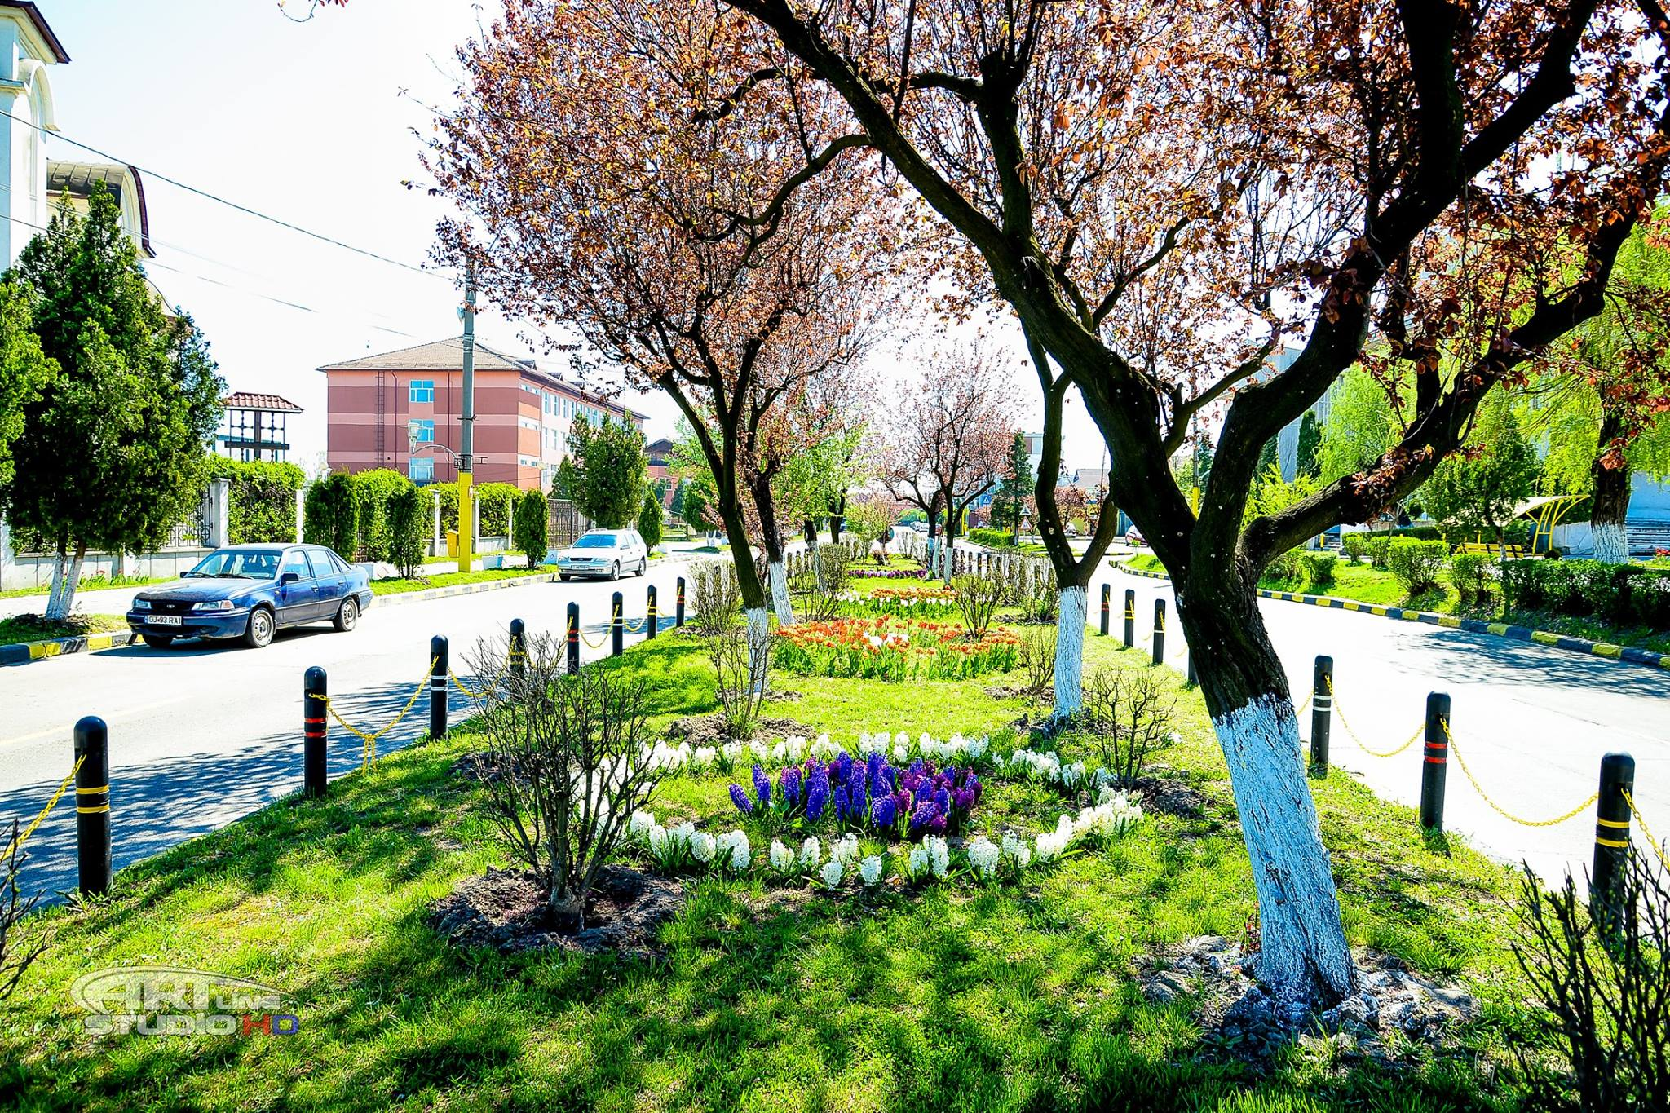
Welcome to Rovinari !

Slide 15
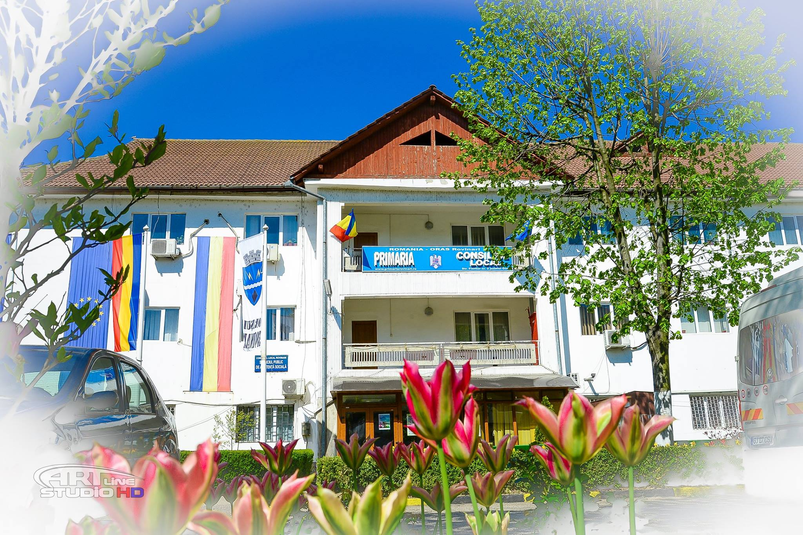
Rovinari City hall

Slide 16
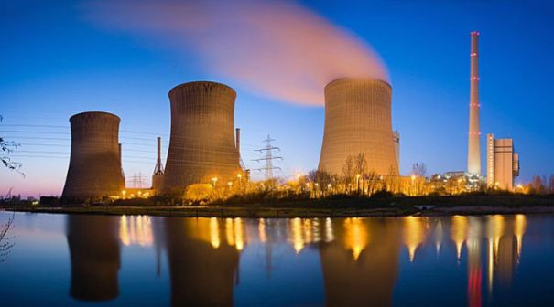
Rovinari city– The Energy wonder
The city of Rovinari is the economic base of charcoal exploitation and the production of electric power in the thermal power plant, being one of the first in Europe as a size.

Slide 17
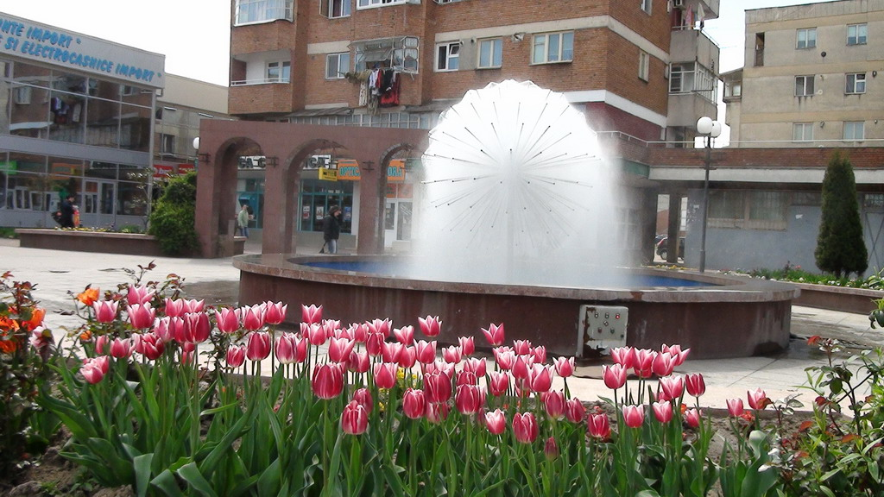
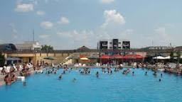
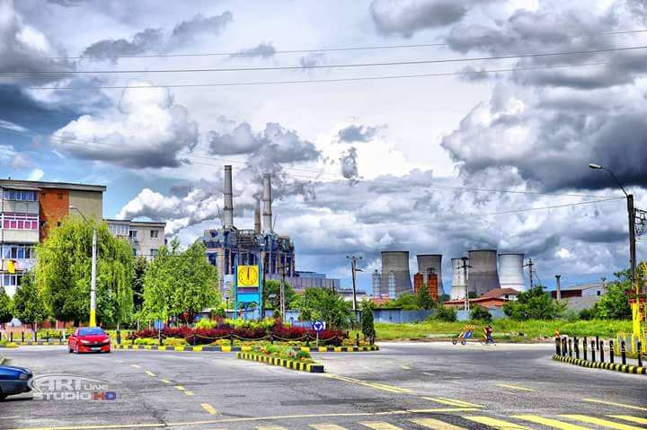
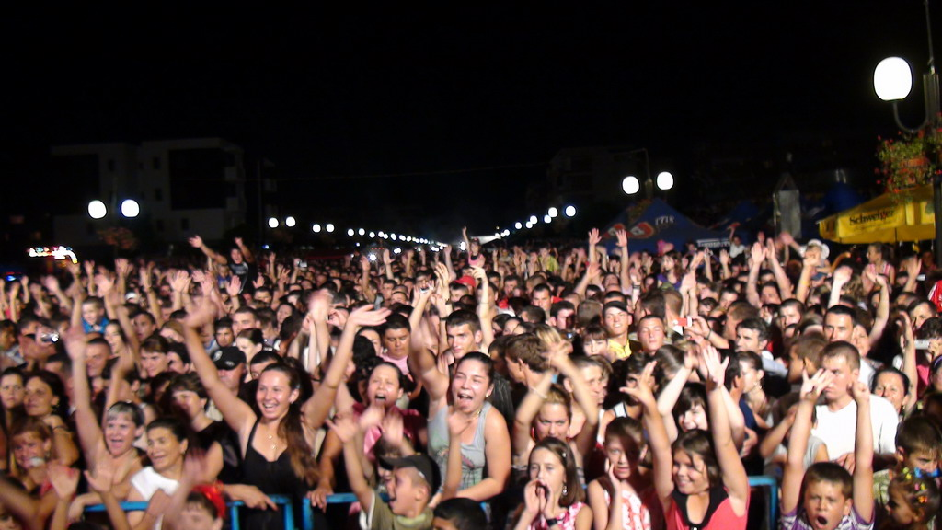
Rovinari - the city of lights and tulips, a young city

Slide 18
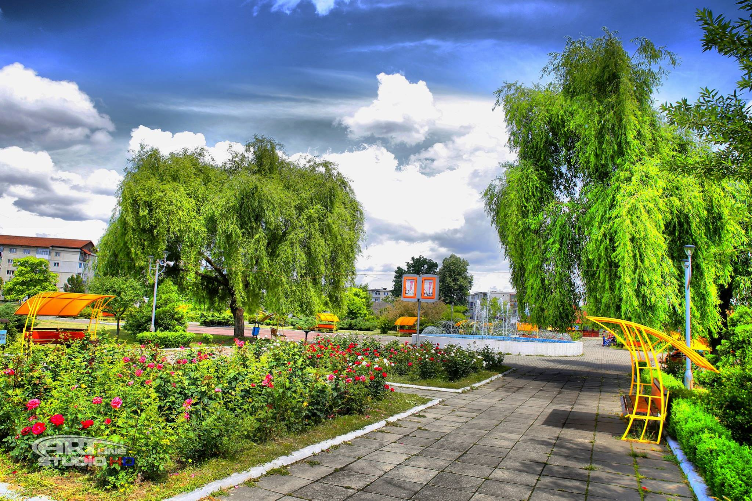
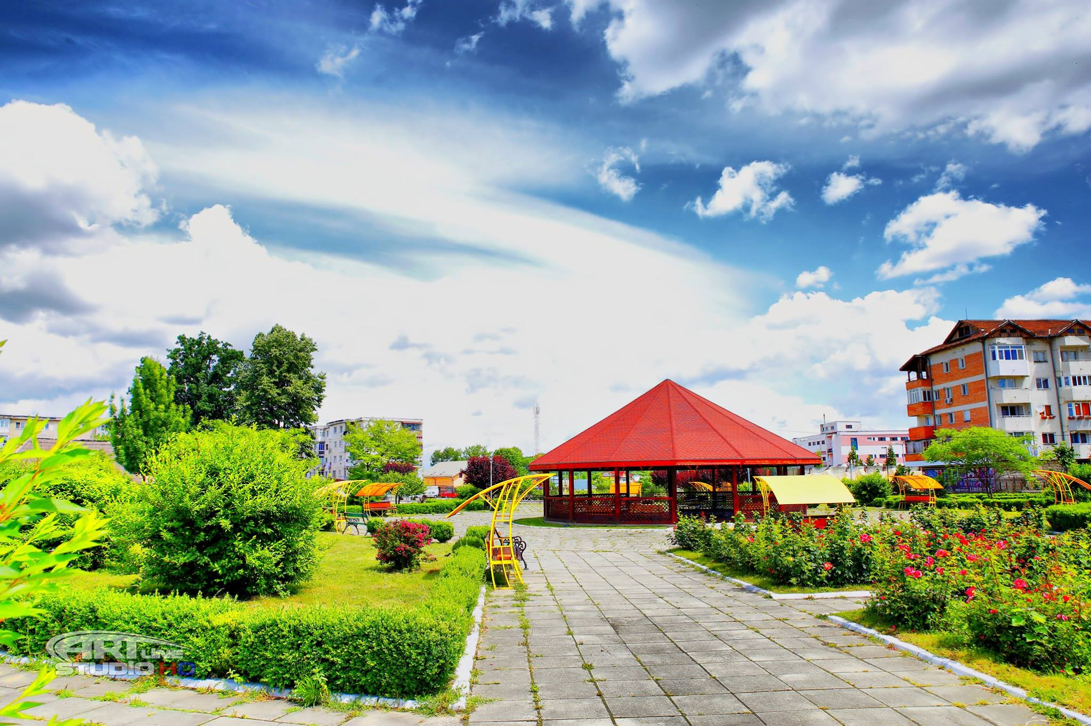
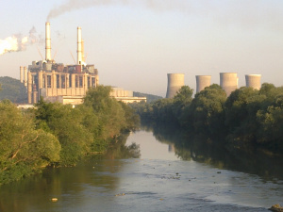
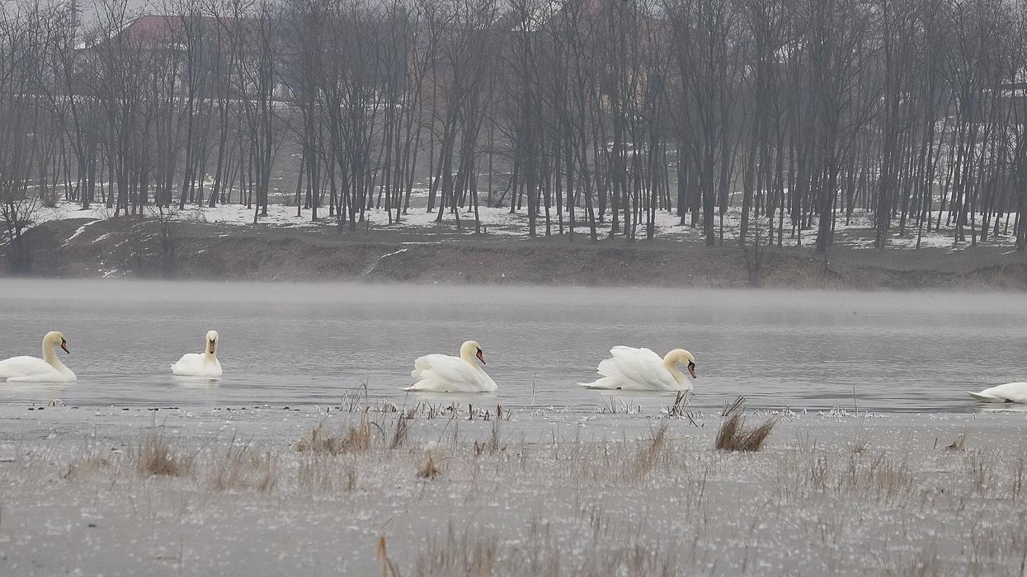
Rovinari – A green and clean town!

Slide 19
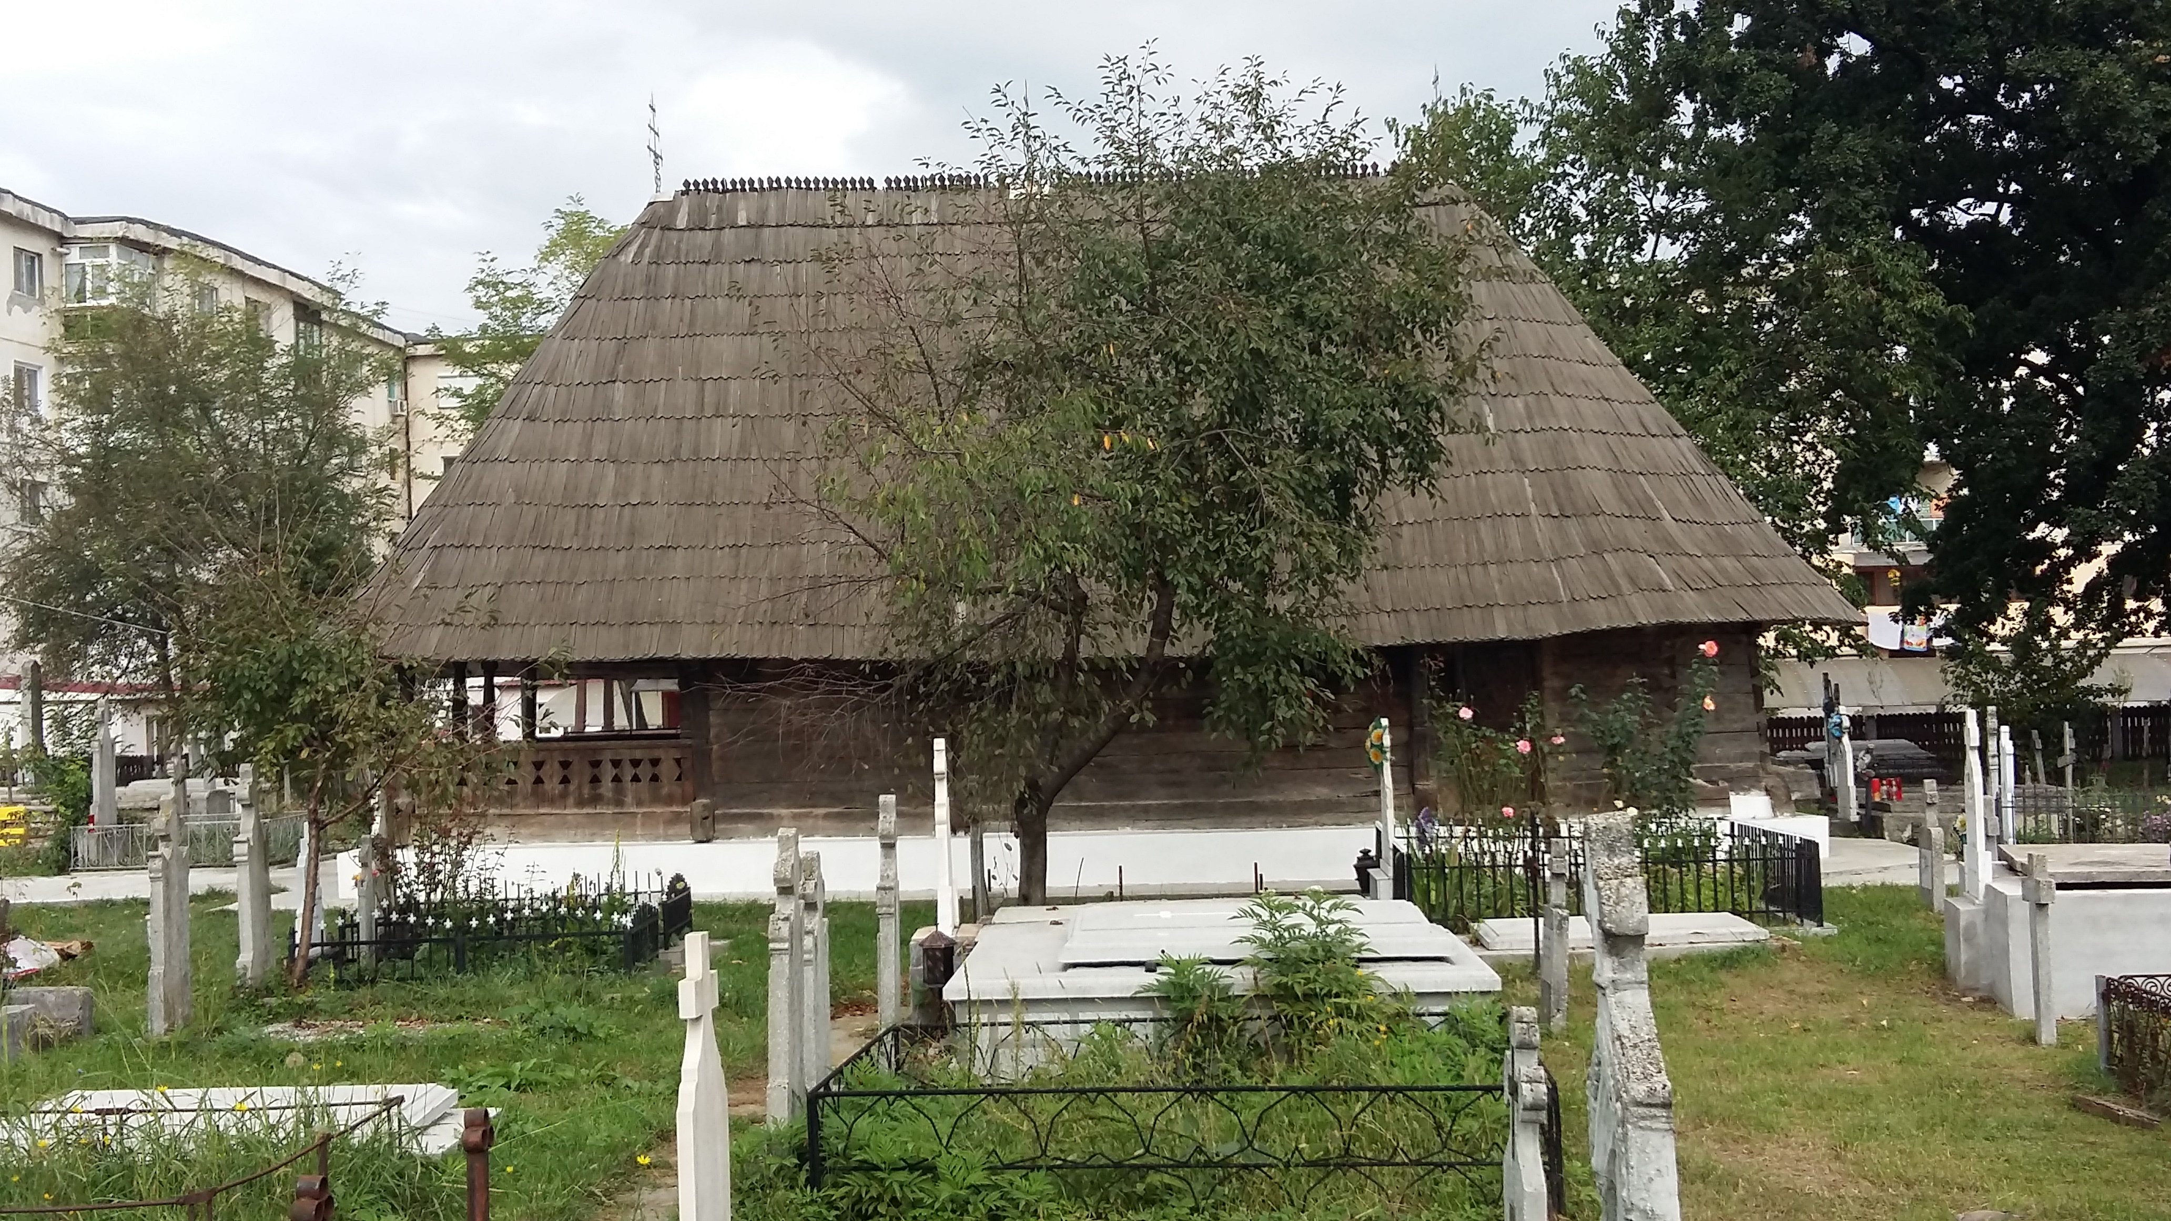
“ Sf. Ioan Botezătorul “Wooden Church
The wooden church "Saint John the Baptist" is a historical monument dating from 1840, built by Gheorghe Roşianul from Roşia and was restored by Gheorghe Tatarescu and his wife Arethia Tatarescu in 1936.

Slide 20
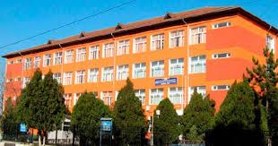
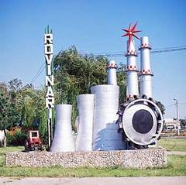
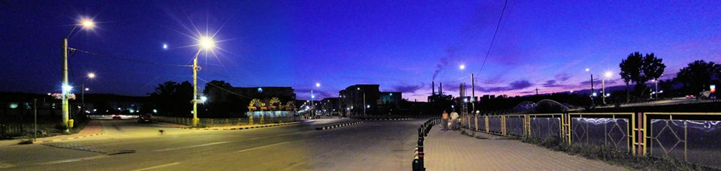
WELCOME TO OUR SCHOOL!

Slide 21
GHEORGHE TATARESCU COLLEGE
“Gheorghe Tatarescu” College is situated in the south-west of Romania in Oltenia region, Gorj county which is a mixture of Romanian history and culture.Our school is a secondary-school level (high-school) and has students aged 15-19 and learn English, French ,IT, Entrepreneurial Education , Music and also Technologies. It provides education in different fields such as:
High school (Sciences ,Humanistic, Tehnical profile-mechanics and electronics,VET school-professional classes)
Courses after high school (Secretary,Tehnician in Chemestry,Numerrically Controlled Machines)
The teaching staff comprises 40 teachers who offer educational and teaching guidance and support to almost 500 students. We have three Informatics labs, a Biology lab, a Chemistry lab, a Physics lab, six technical labs for practice, an interesting library, an amphitheatre and a gym.The teaching staff is fully engaged in the learning process and improvement of the quality of school work. We are open to innovation and change.

Slide 22
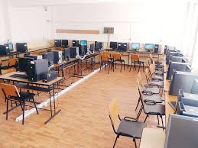
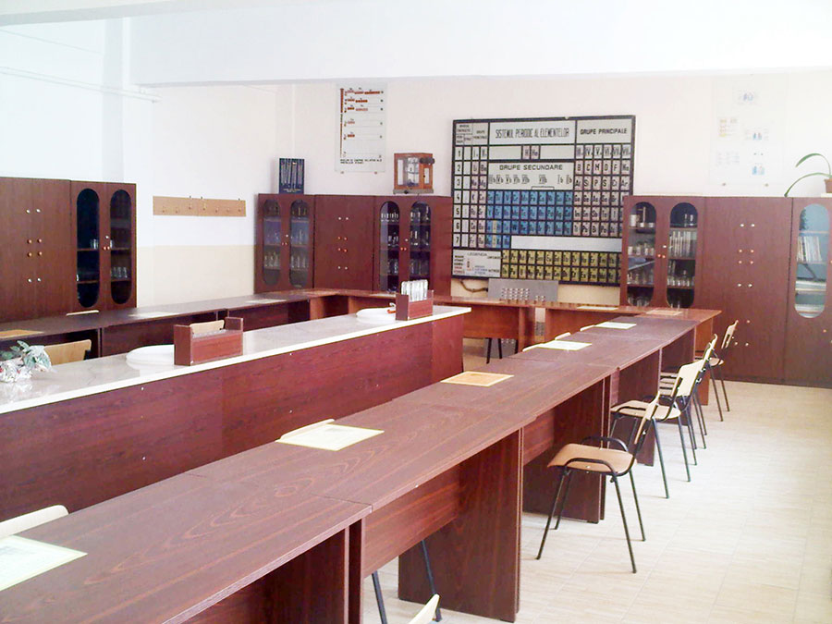
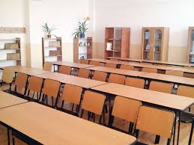

Slide 23
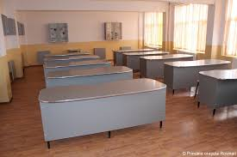
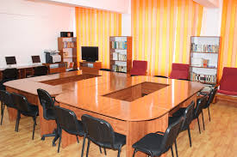

Slide 24
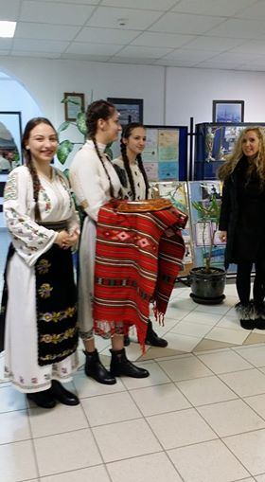
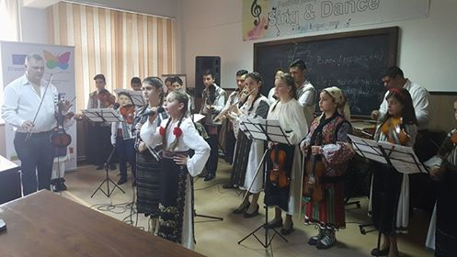

Slide 25
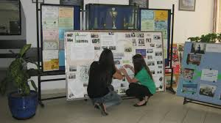
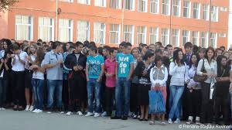

Slide 26


SCHOOL ACTIVITIES

Slide 27



Slide 28



Slide 29




Slide 30


SPORTS ACTIVITIES

Slide 31



Slide 33
This material was made by the Romanian project team
This project has been funded with support from the European Commission.
This publication [communication] reflects the views only of the author, and the Commission cannot be held responsible for any use which may be made of the information contained therein.

