Slide 1
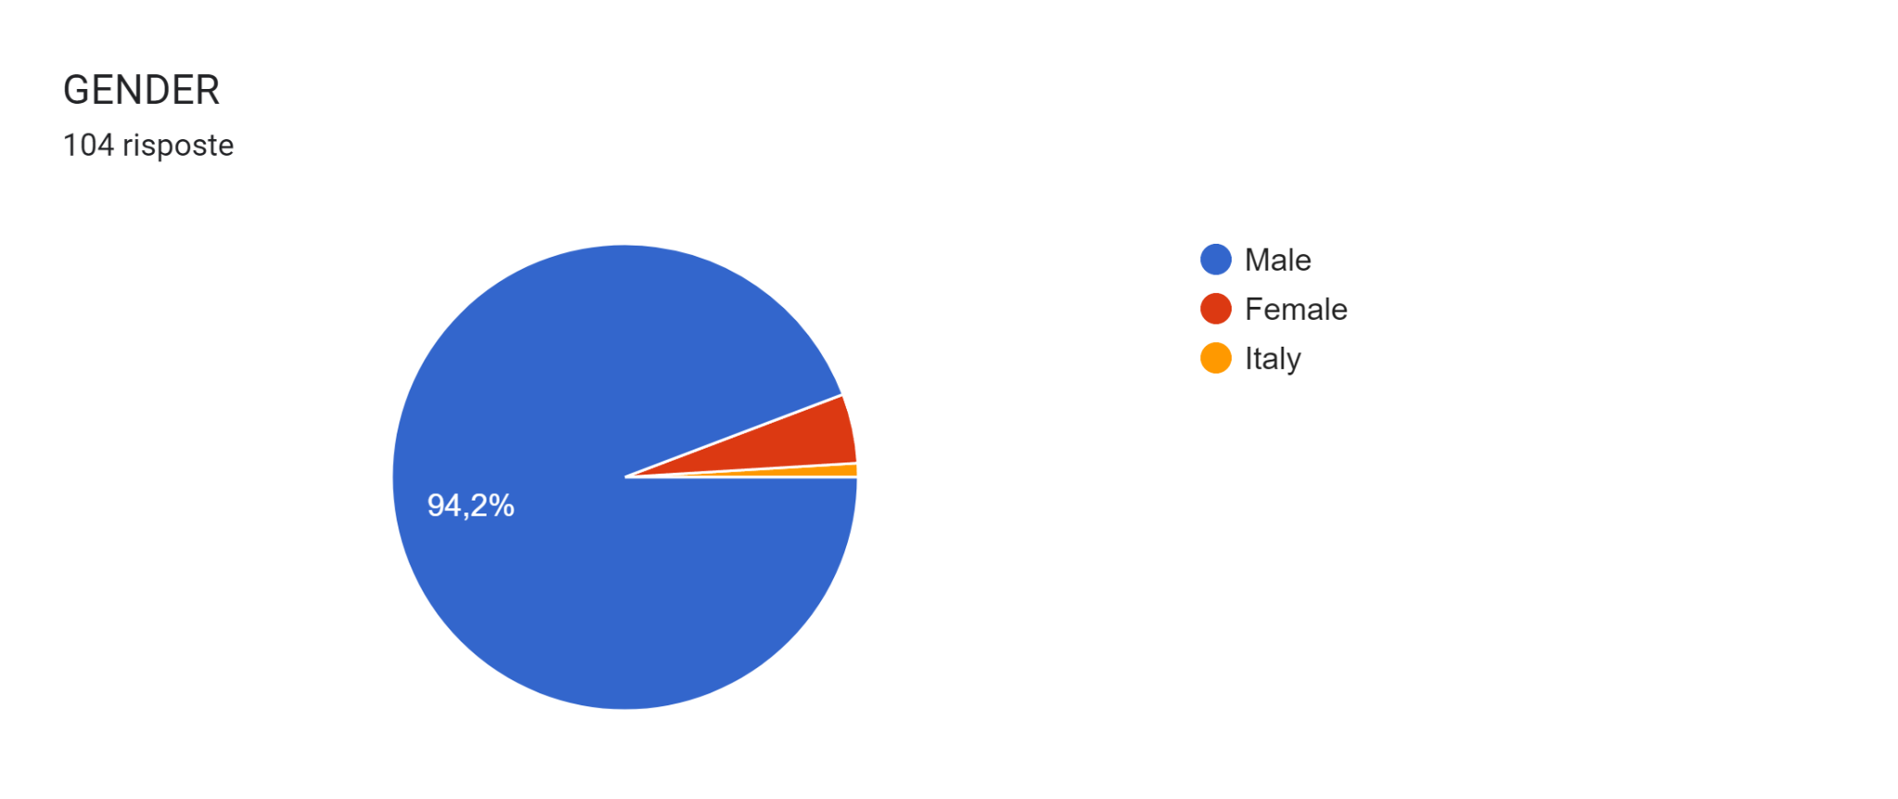
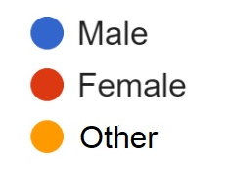
OUR SCHOOL CONTRIBUTION

Slide 2
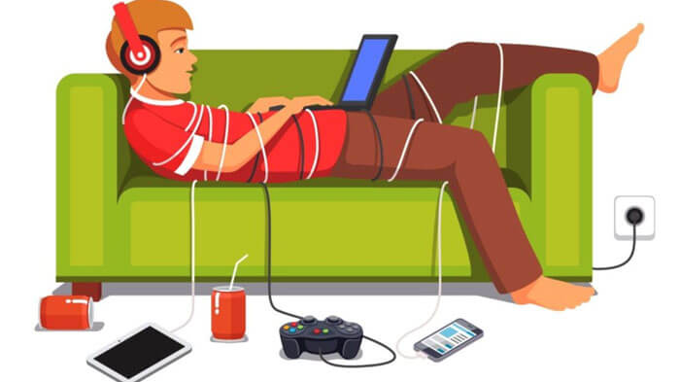
NO.MO.PR.HE SURVEY’S RESULTS
TECHNOLOGY ADDICTION

Slide 3
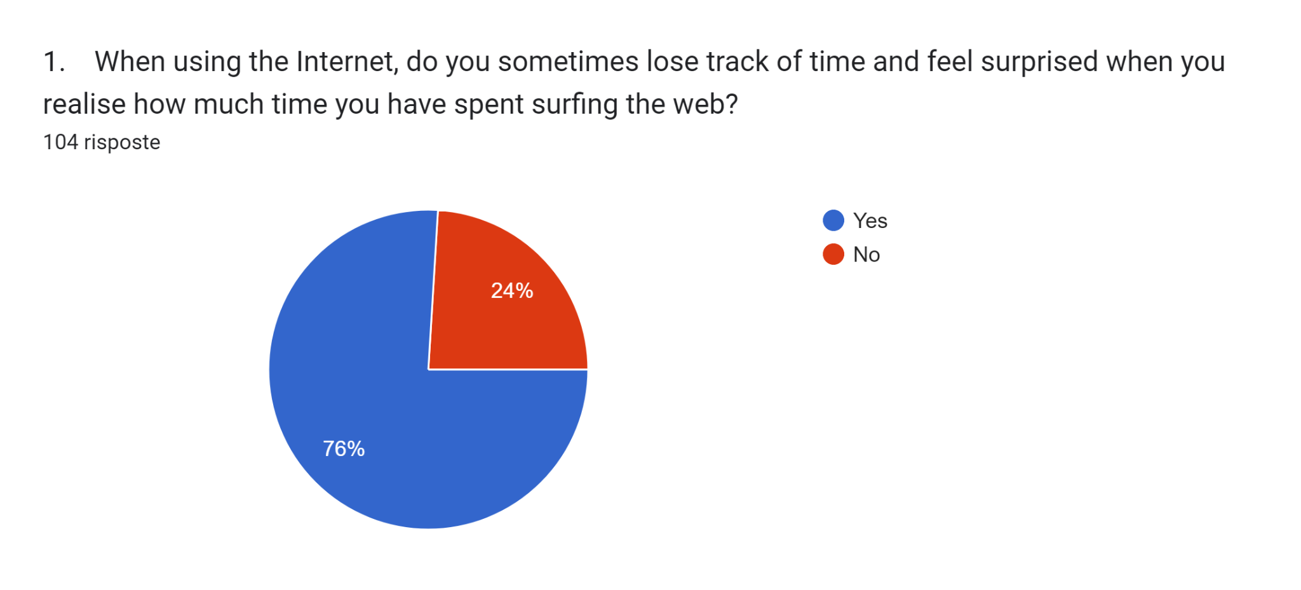
HOW OFTEN DO YOU LOSE CONTROL?

Slide 4
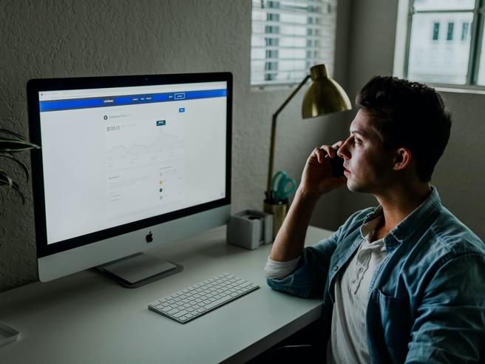
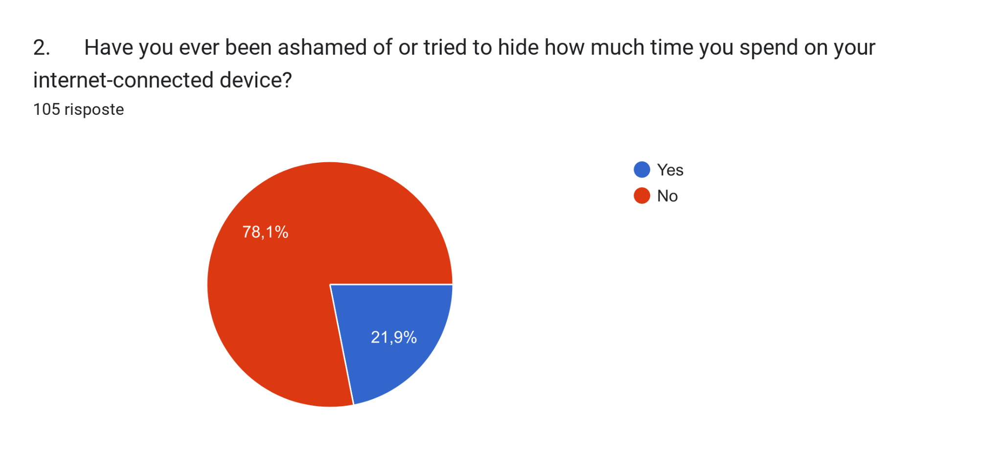
TIME SPENT ON DEVICES… Do I try to hide it???

Slide 5
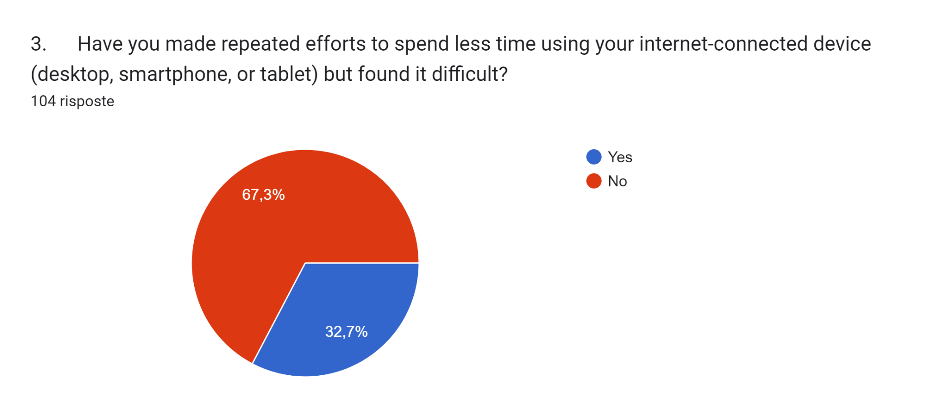
HOW TO SPEND LESS TIME ON THE INTERNET?

Slide 6
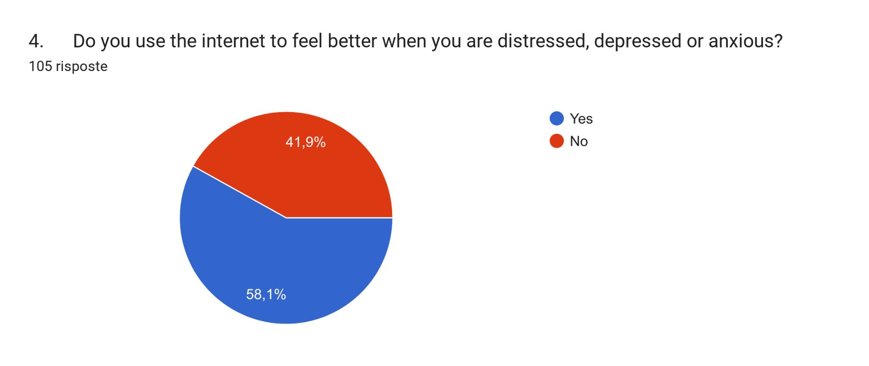
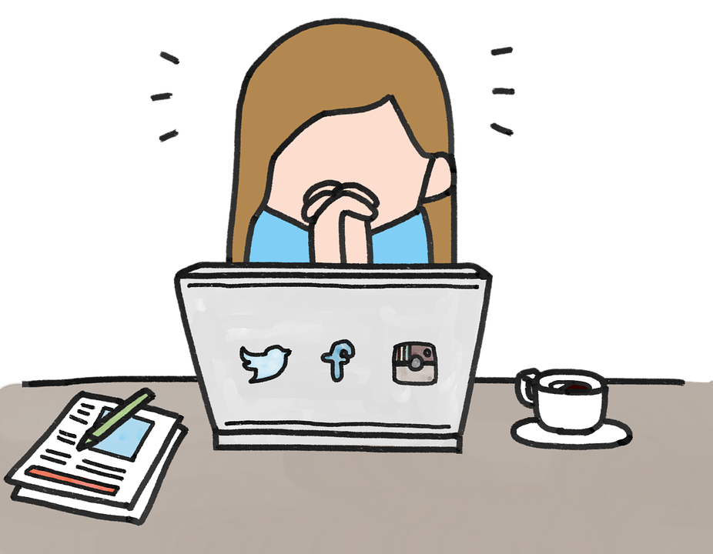
INTERNET AS A CURE

Slide 7
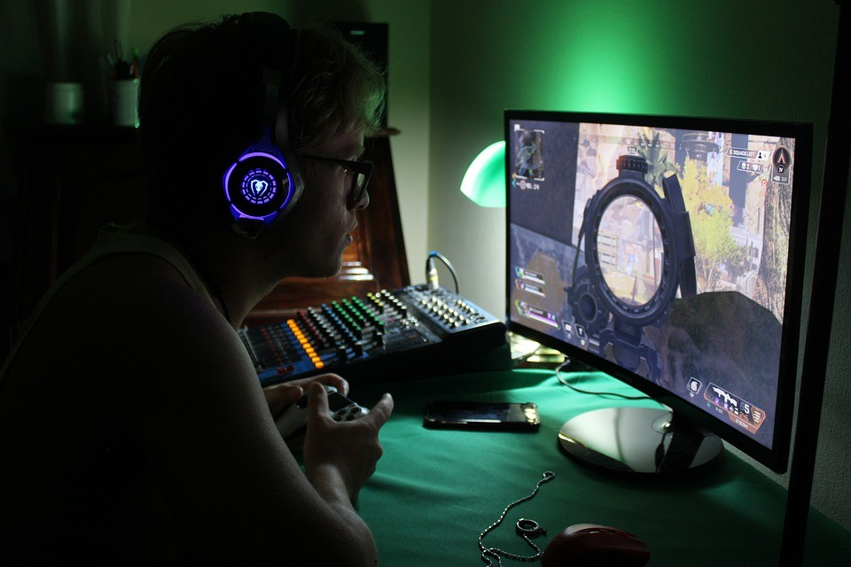
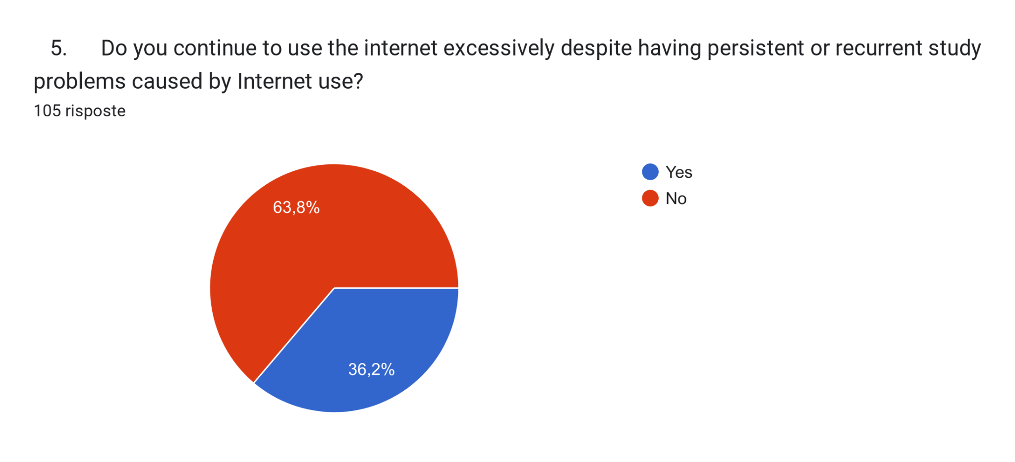
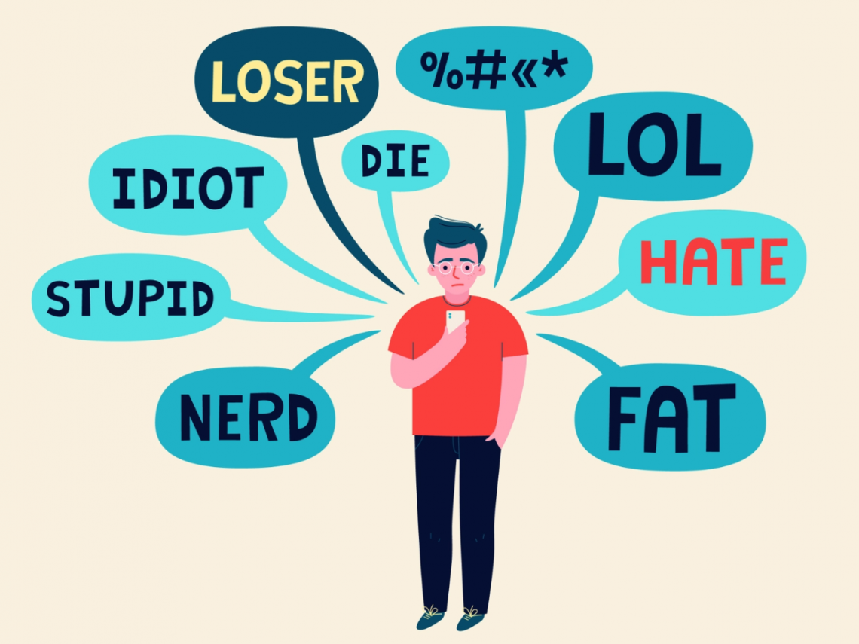
THE DIFFERENT WAYS TO USE DEVICES
HEALTHY or UNHEALTHY?

Slide 8
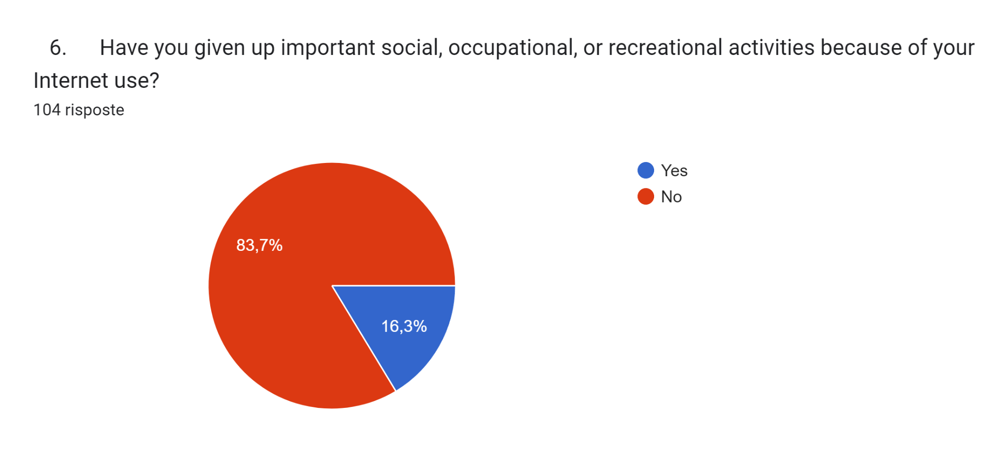
ARE YOU GIVING UP YOUR SOCIAL LIFE?

Slide 9
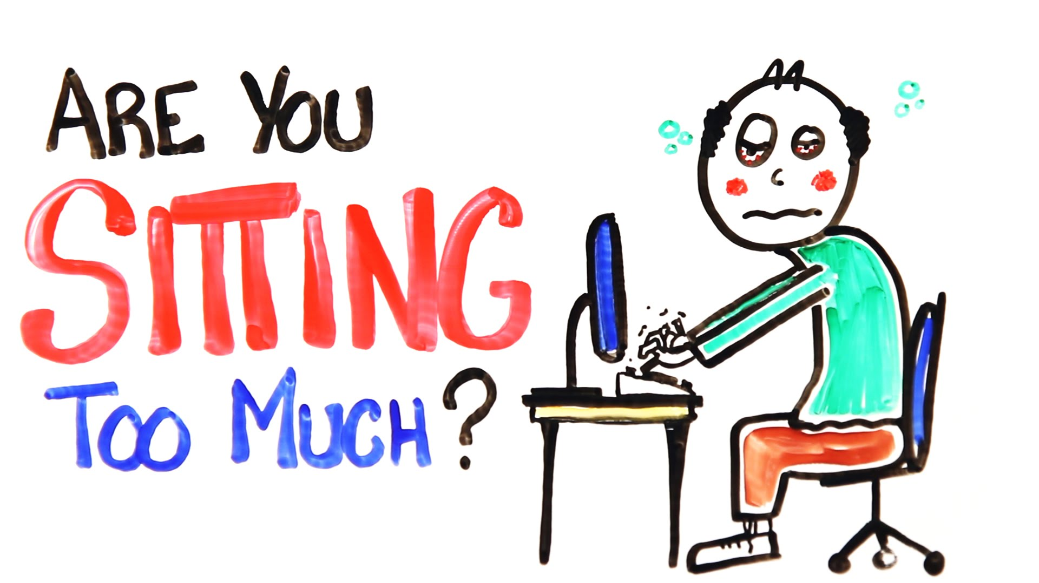
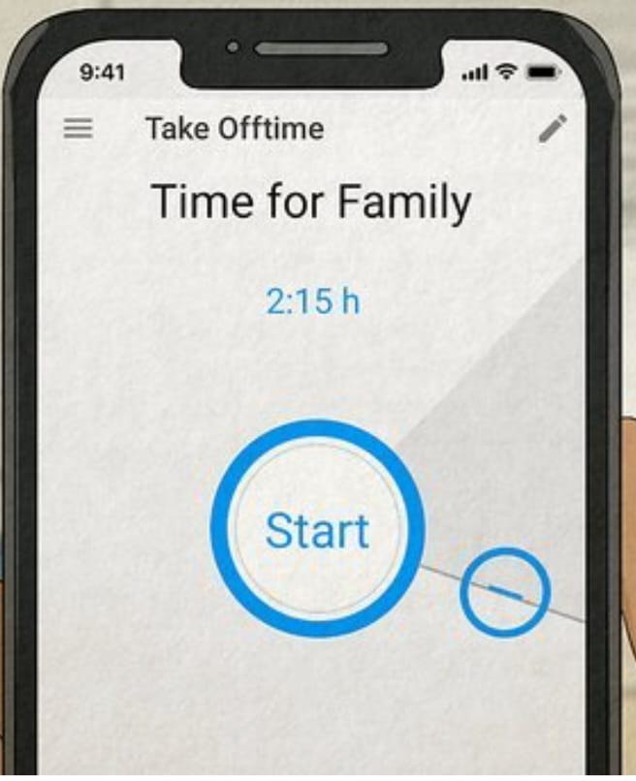
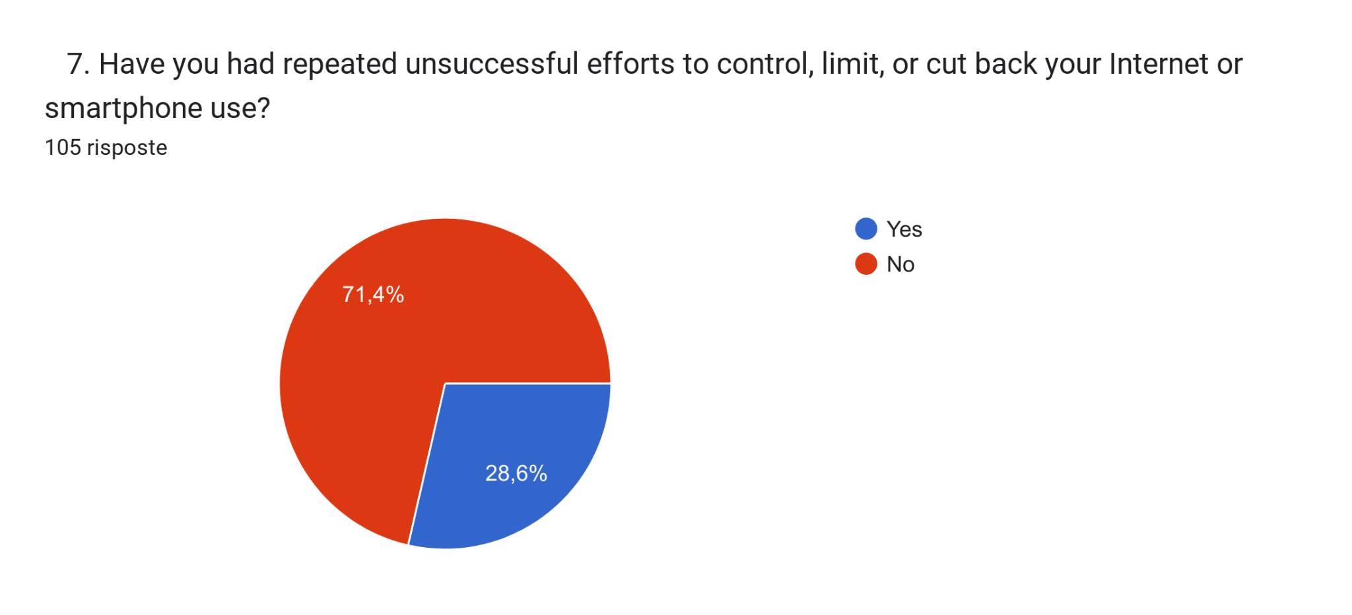
EFFORTS TO REDUCE INTERNET USAGE

Slide 10
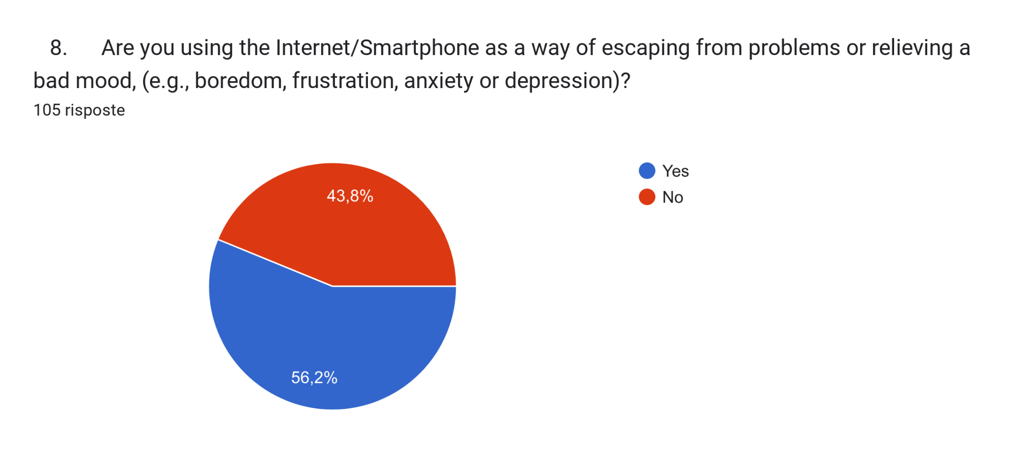
IS IT A WAY OF ESCAPE?

Slide 11
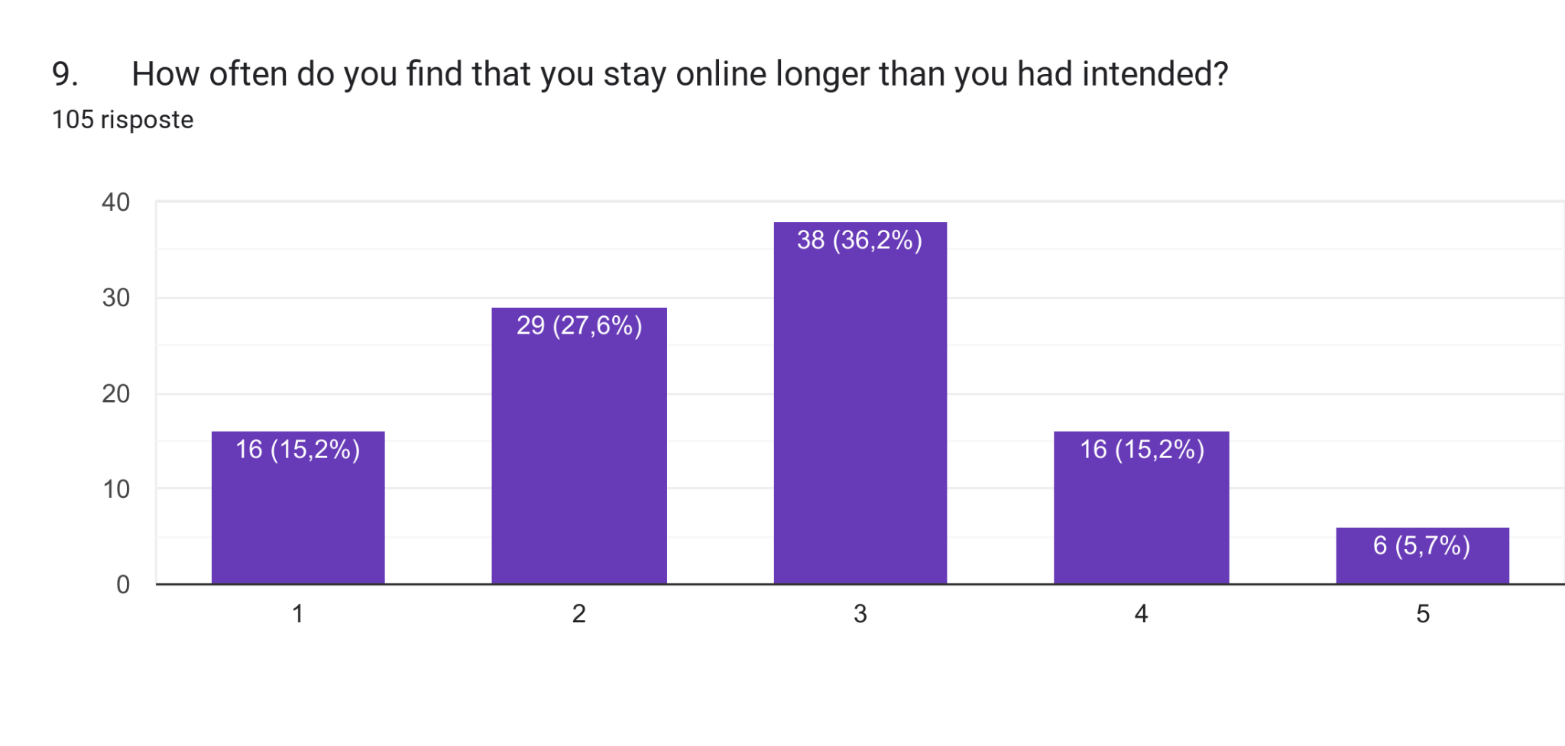
LOSING CONTROL OVER TIME

Slide 12
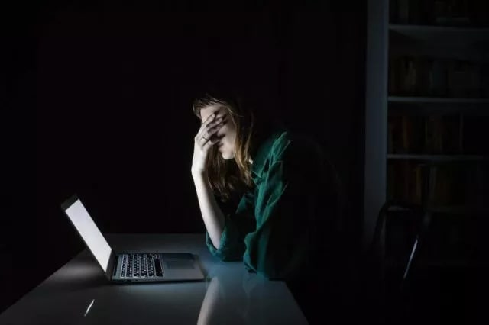
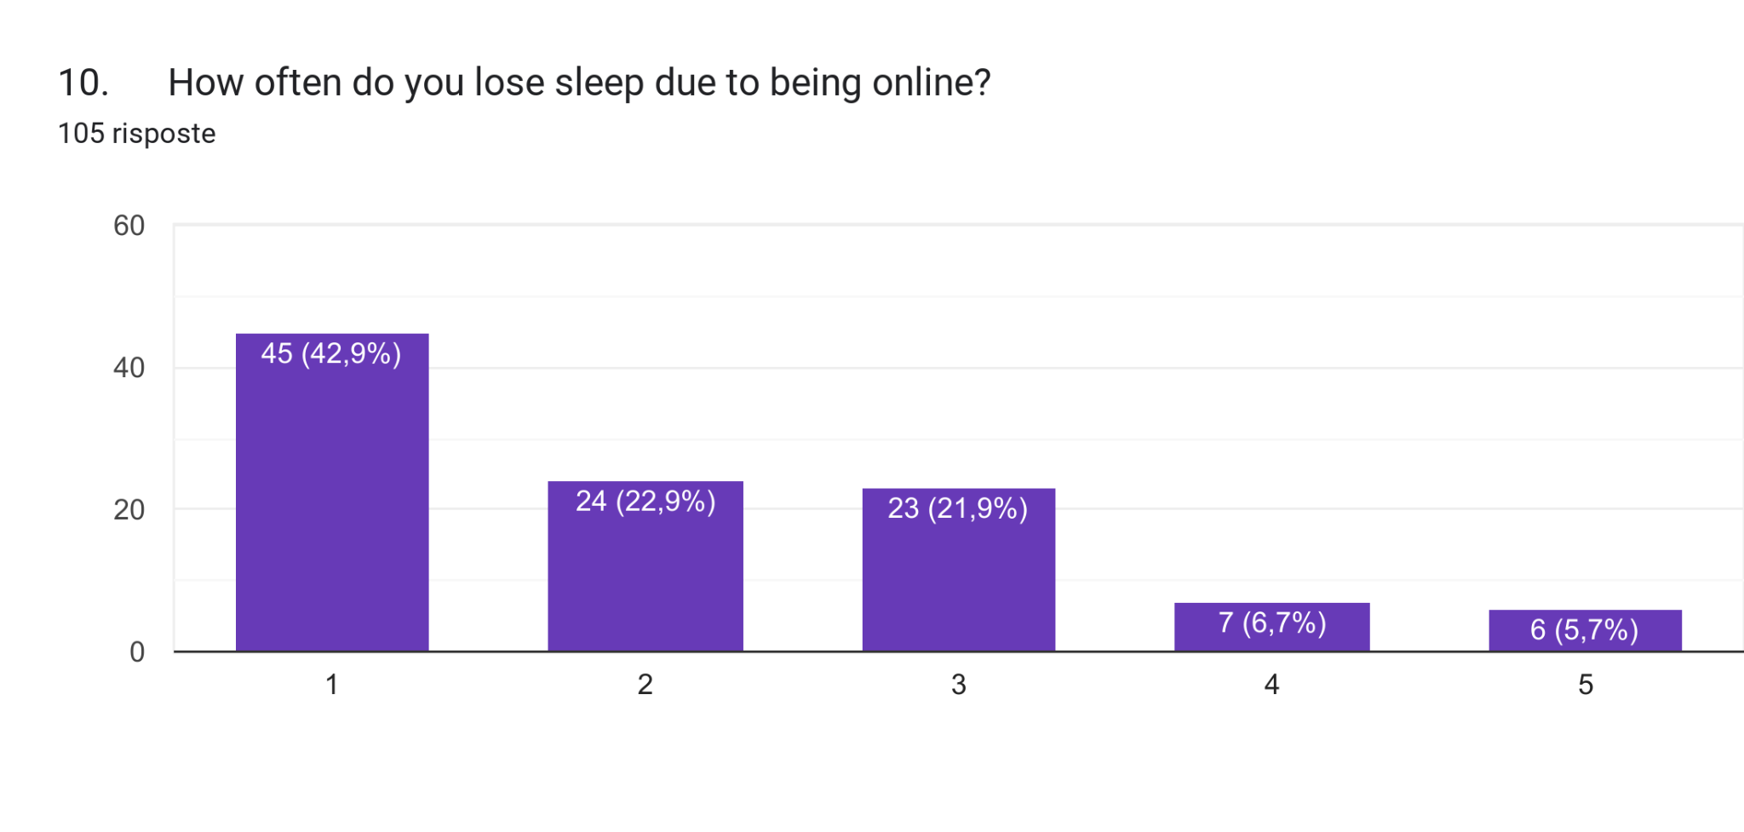
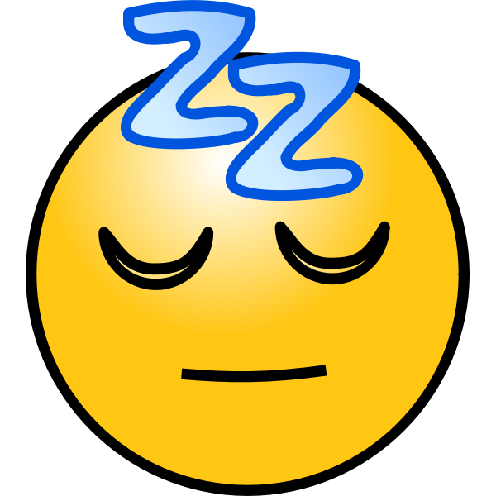
LACK OF SLEEP

Slide 13
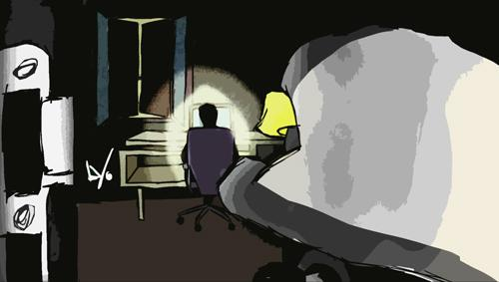
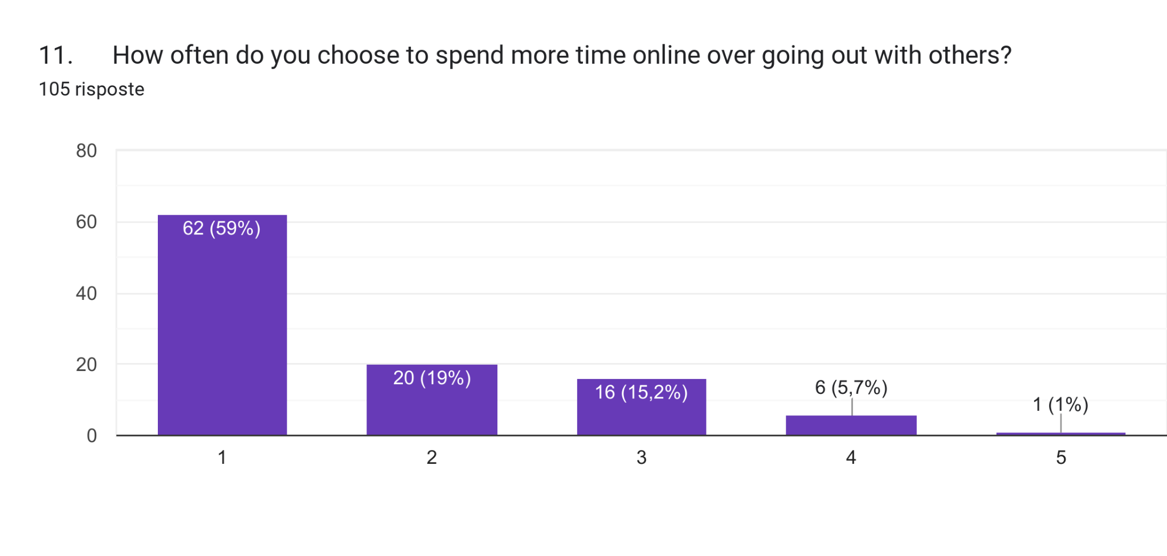
CHOICES AND CONSEQUENCES: IN or OUT?

Slide 14
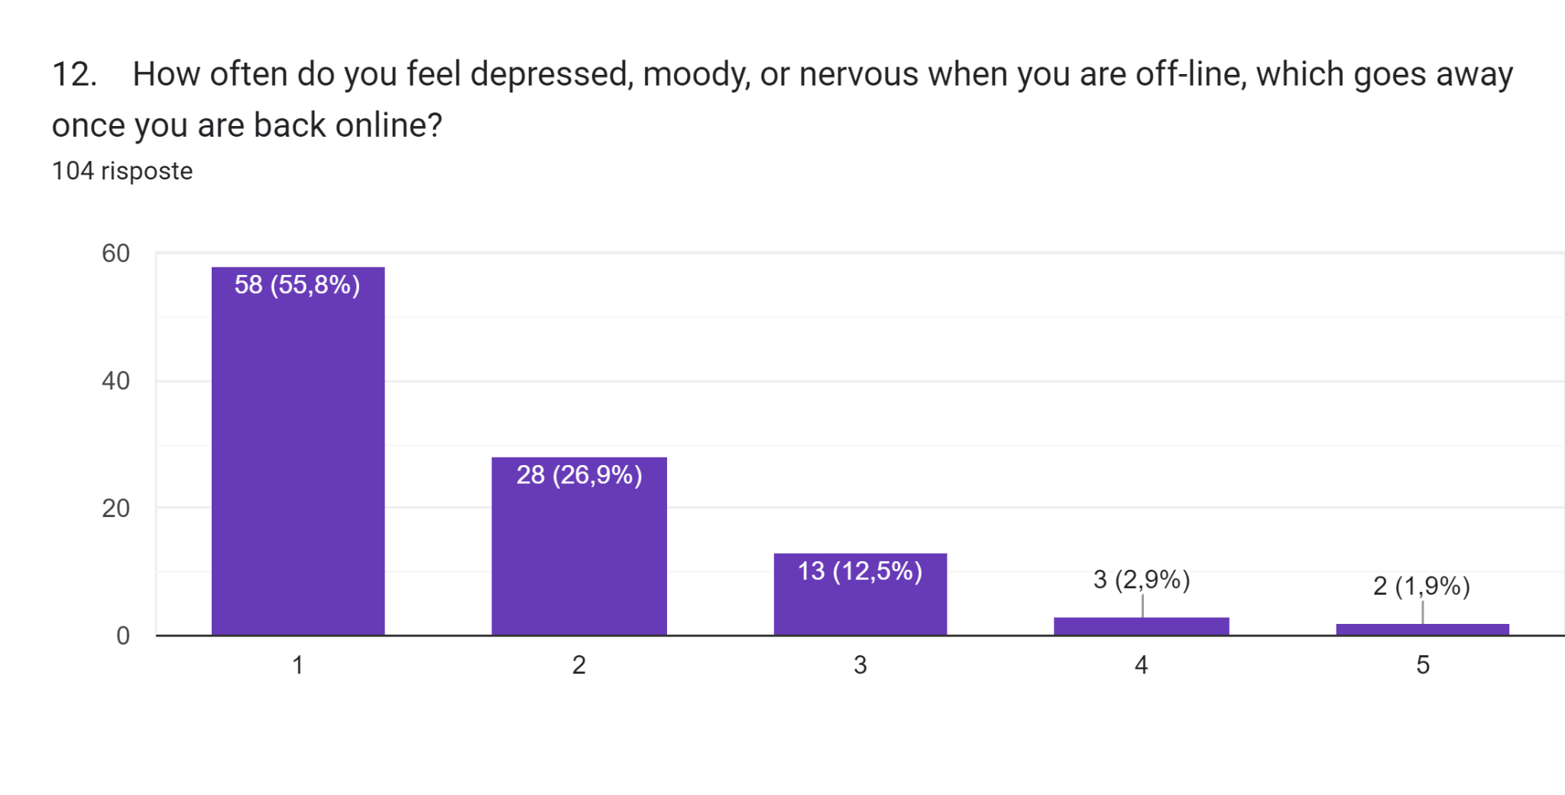
THE OFFLINE PROBLEM

Slide 15
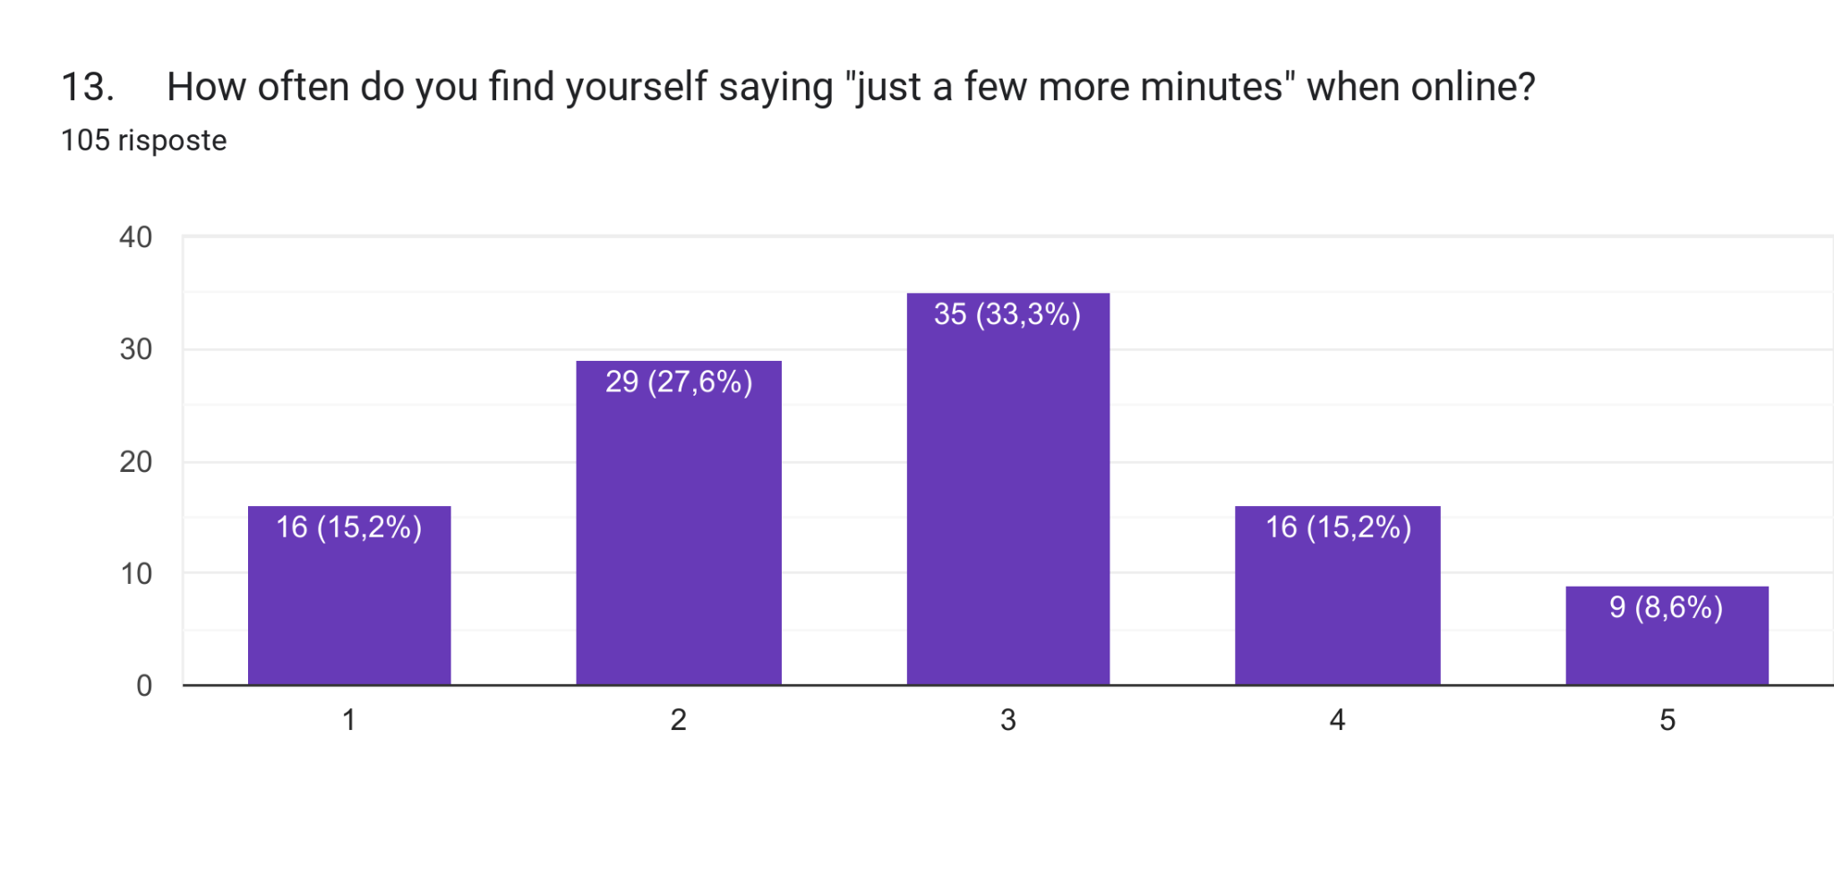
ONLINE ADDICTION

Slide 16
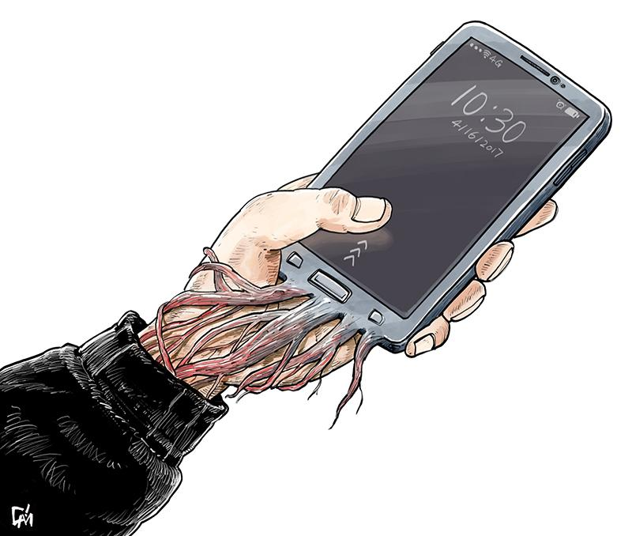
PHONE ADDICTION ?

Slide 17
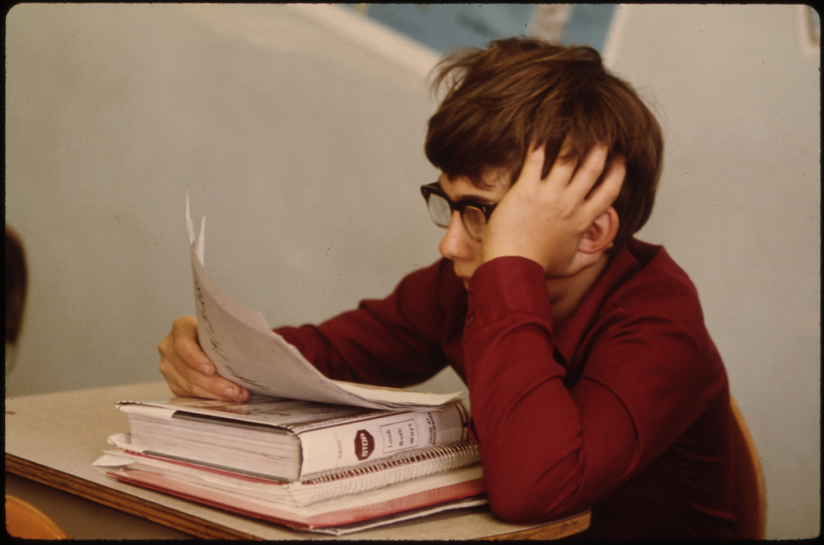
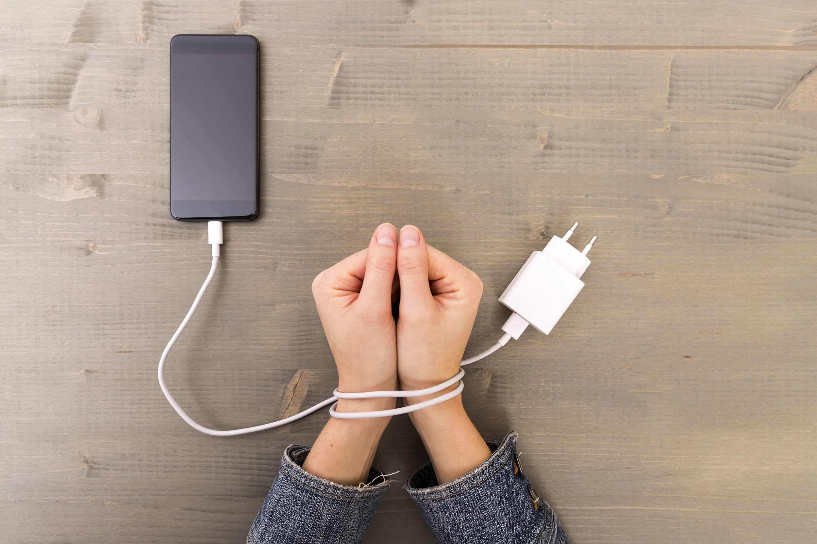
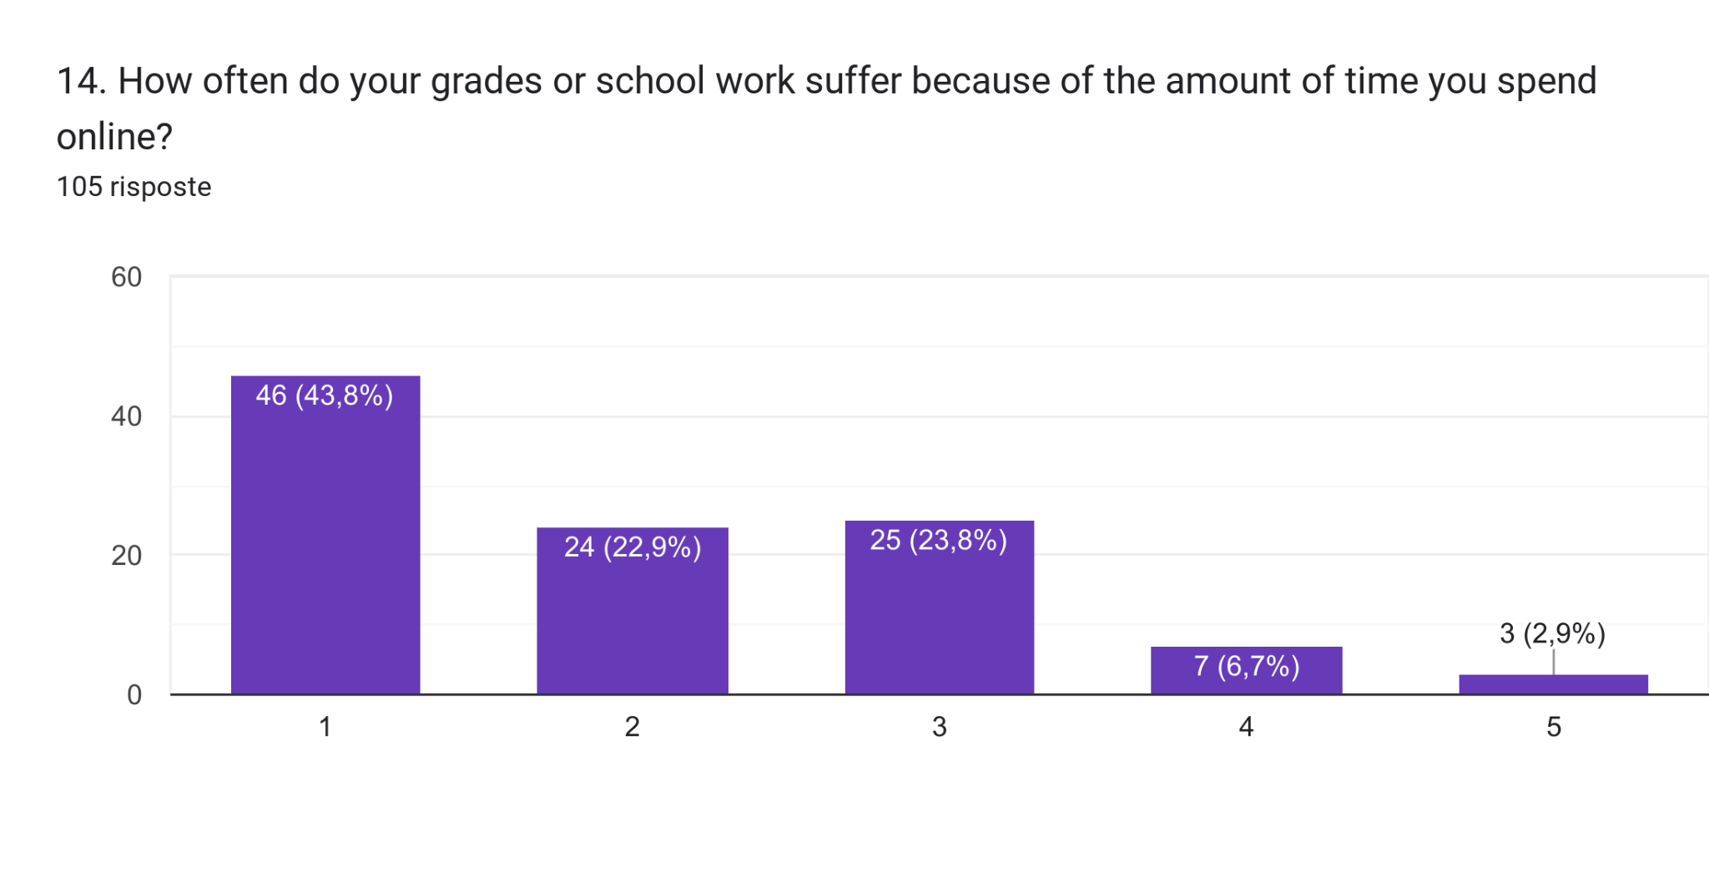
DOES THE USE OF DEVICES NEGATIVELY AFFECT YOUR STUDY EFFORT??

Slide 18
TO SUM UP
LOSING TRACK OF TIME
TRYING TO HIDE TIME SPENT ON SURFING THE NET
USING THE INTERNET AS A CURE
MORE TIME ONLINE THAN OUT WITH OTHERS (reducing social and healthy life)
SLEEPING PROBLEMS
OTHERS’ COMPLAINTS
FEEL DEPRESSED WHEN OFFLINE
NEGATIVE IMPACT ON GRADES AND STUDYING
(MAINLY NEGATIVE ASPECTS)

Slide 19
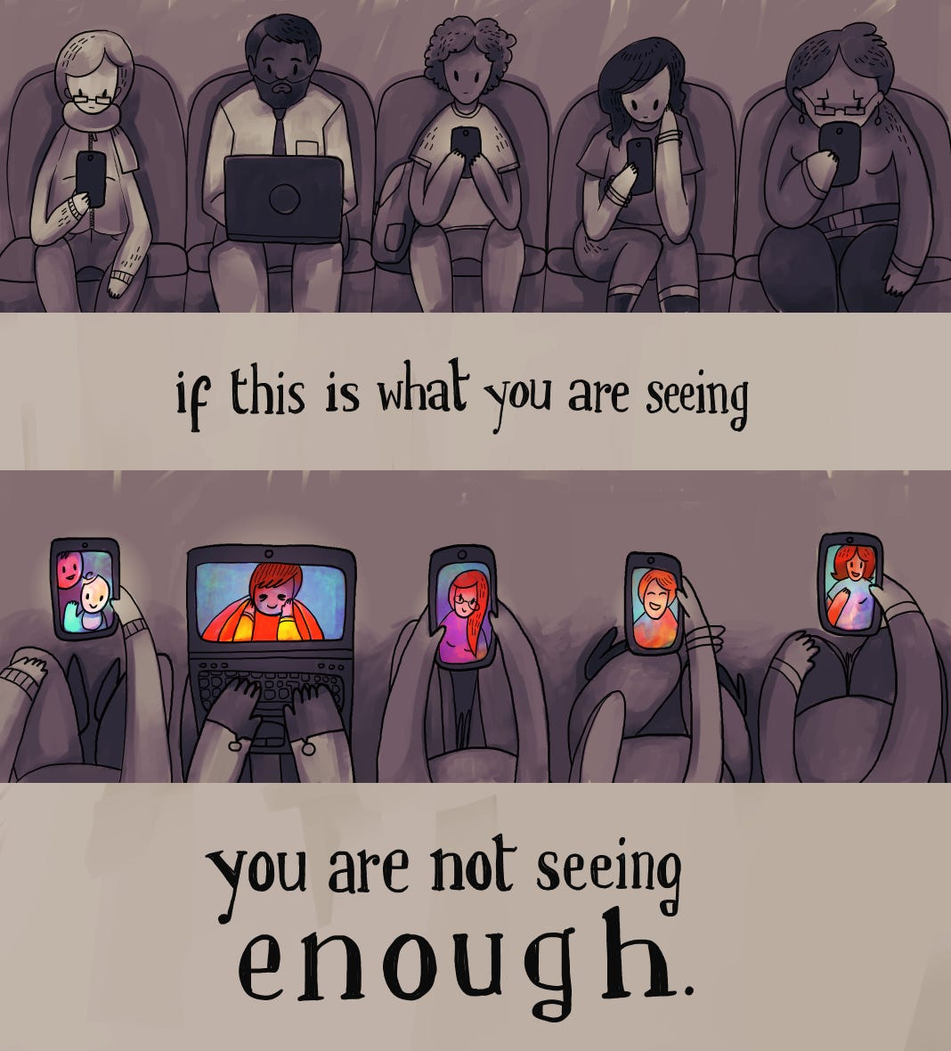
LESS MOBILES MORE REAL LIFE

Slide 20
THANK YOU….
DAVIDE BIANCO
FRANCESCO CACCAVALE
FRANCESCO GESUELE
FRANCESCO MANNA

