Slide 1
Technology addictions – causes and solutions.

Slide 2
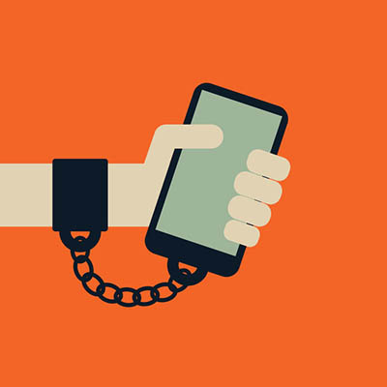
What is technology addiction?
Technology addiction can be defined as frequent and obsessive technology-related behavior increasingly practiced despite negative consequences to the user of the technology

Slide 3
5 thinks that causes technology addiction:
video and computers games
smartphones and tablets
social media
internet

Slide 4
Video and computer games
This technology addiction is known as a gaming disorder and is the compulsive use of video games or smartphone applications.

Slide 5
Smartphones and tablets
These devices are mobile, allowing for easy and regular access to the internet and various applications.

Slide 6
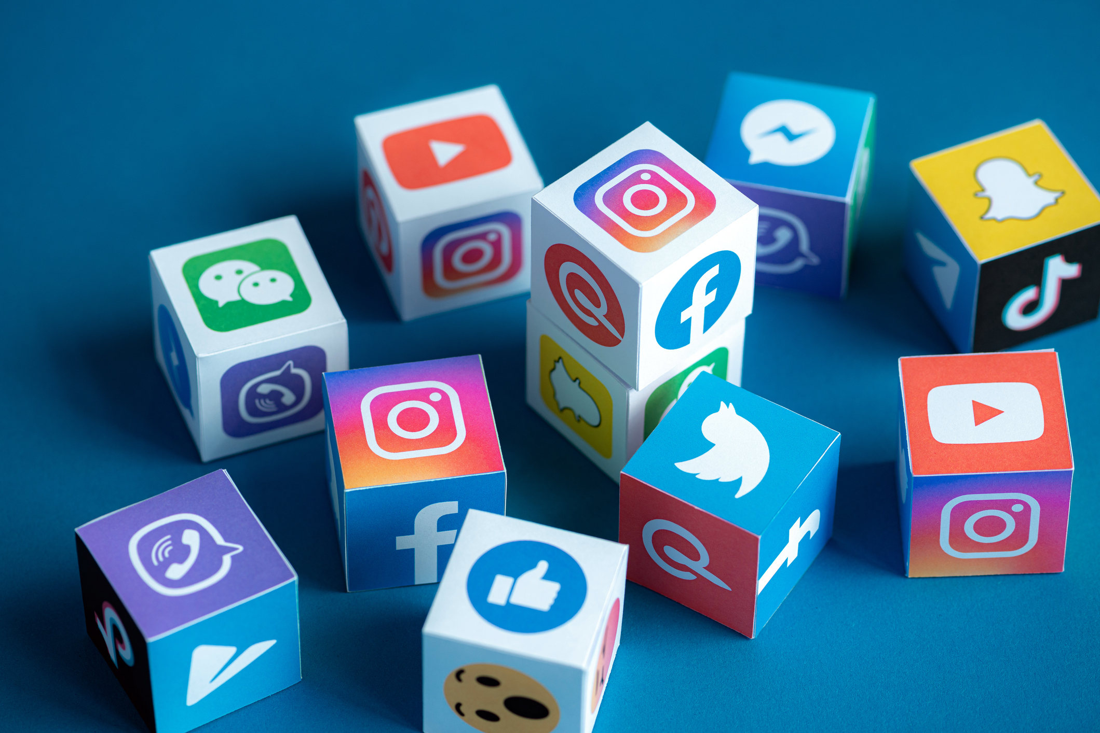
Social Media
YouTube, Facebook, Twitter, Instagram, and Snapchat are examples of these individualized portals of information.

Slide 7
Internet
. Internet use disorder is the most common form of technology addiction. This is usually seen with excessive online activity from social media, web searches, and constant use of smartphones

Slide 8
Solutions for technology addiction

Slide 9
Turn off push notifications

Slide 10
Replace smartphone use with something you value

Slide 11
Project was done by: Dziugas,Francesco Manna,Stefonie Gheorghe,Tomescu Sorina-Valentina Serban Cristi Adrian

